Slide 1
6th Annual Civility Lunch and Learn for the Criminal Bar
December 4, 2024
1-3pm
Up to 2 hours of CPD credit available

Slide 2
Hosts:
Gloria Ng, defence counsel and President of CDAS
Andrea Spence, Professional Development Crown Counsel, BC Prosecution Service.
Panelists:
The Honourable Justice Baljinder Kaur Girn of the BC Supreme Court;
The Honourable Judge David St. Pierre of the BC Provincial Court;
Phil Riddell KC, defence counsel and Life Bencher for the Law Society of BC;
Daniel Song KC, defence counsel;
Kevin Westell, defence counsel and Bencher, Law Society of BC;
Mike Wheeler, Crown Counsel, Public Prosecution Service of Canada;
Nadia K. Farinelli, Deputy Director Legal Resources, Learning & Development, BC Prosecution Service; and
Lisa Dumbrell, Crown Counsel, BC Prosecution Service.

Slide 3
What is civility and why is it important? Civility is a part of professionalism for lawyers. At its core, it is this notion of respect …. respect for the system of justice and the players in the system. This is why civility is especially important for those of us who practice before the courts. What we must show our community is that we ourselves have enough confidence in the rule of law and the administration of justice to accord a place of respect to the competing view.
Principles of Civility for Advocates, The Advocates’ Society Institute for Civility and Professionalism

Slide 4
Law Society of BC Code of Professional Conduct
The Canons of Legal Ethics are included in Chapter 2 of the Law Society of BC Code of Professional Conduct.
A version of the Canons has formed part of the Code of Professional Conduct since 1921.
The Canons are a general guide to a lawyer’s duties to the courts, clients and other lawyers.
The Canons state: A lawyer is a minister of justice, an officer of the courts, a client’s advocate and a member of an ancient, honourable and learned profession. In these several capacities, it is a lawyer’s duty to promote the interests of the state, serve the cause of justice, maintain the authority and dignity of the courts, be faithful to clients, be candid and courteous in relations with other lawyers and demonstrate personal integrity.
Rule 2.1-4 provides: A lawyer’s conduct to other lawyers should be characterized by courtesy and good faith. Any ill feeling that may exist between clients or lawyers, particularly during litigation, should never be allowed to influence lawyers in their conduct and demeanor toward each other or the parties. Personal remarks and references between lawyers should be scrupulously avoided, as should quarrels between lawyers that can cause delay and promote unseemly wrangling. Rule 7.2-1 provides: A lawyer must be courteous and civil and act in good faith with all persons with whom the lawyer has dealings in the course of their practice.

Slide 5
Civility is also relevant to health and well-being. The role of a lawyer is often stressful and incivility can increase negative emotions and burnout. Lawyers can diffuse tensions and decrease hostility by practicing in a more civil manner. It may feel right in the heat of the moment to respond to a pushy client or an aggressive opposing counsel in a cutting manner, but in the long term this may do more harm than good. In such situations, lawyers should strive to apply the golden rule — “treat others as you want to be treated.”
Civility Best Practices, Law Society of Alberta (October 2024)

Slide 6
View from the Bench

Slide 7
5 Top
Tips for Civility

Slide 8
1.
Overreliance on emails – don’t be afraid to pick up the phone or interact in- person

Slide 9
2.
Virtual Court is still Court

Slide 10
3(a)
Maintain respect for witnesses and accused persons

Slide 11
3(b)
Treat professional staff, courtroom staff and non-lawyers with respect and integrity

Slide 12
Law Society of BC v. Cherniack, 2022 LSBC 36
Law Society of BC v. Davison, 2022 LSBC 23
Law Society of BC v. Heflin, 2022 LSBC 41
Law Society of BC v. Johnston 2023 LSBC 16

Slide 13
4.
Understanding Diversity and Speaking Up Against Unfair Treatment

Slide 14
Familiarize yourself with the challenges your colleagues face: But I was Wearing a Suit (Parts I and II) [Grassroots Project by Indigenous Lawyers] But I Look Like a Lawyer [Federation of Asian Canadian Lawyers BC]

Slide 15
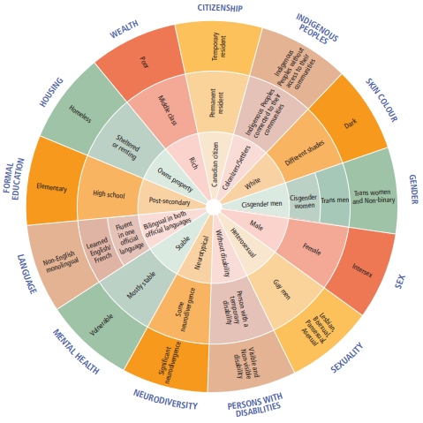
Wheel of Privilege and Power

Slide 16
5. Maintain Civility in the Face of Incivility

Slide 17
Scenarios

Slide 18
Opposing counsel advises you in person, in email, or on the record that something you have said or done felt to them to be unprofessional or lacked civility. You don’t think you have done anything of the sort – how can you respond?

Slide 19
Civility Challenges from the Bench What are your options in the moment and later, if you think you are experiencing incivility from the Bench?

Slide 20
Opposing Counsel comes to you on the eve of trial to say they have a personal crisis and cannot attend the trial, they are seeking an adjournment. If opposing counsel is defence, what do you do as Crown? What position do you take, what do you say on the record, what do you say to counsel? If opposing counsel is Crown with a personal crisis, and as defence, your client really needs this trial to go ahead – what do you do?

Slide 21
In a trial for sexual assault, you notice the complainant is starting to visibly become upset. The intrusiveness of the questions is debatable. As Crown what can you do? As defence what can you do? Does it matter if this occurs during direct or cross-examination?

Slide 22
Where is the line between zealous advocacy and incivility bordering on professional misconduct? As defence, what challenges do you sometimes face when a client has certain expectations of how you will conduct their case?
As Crown, how do you avoid allegations of prosecutorial misconduct? As a judge, how does it affect your job when dealing with acrimonious interactions between counsel?
The Supreme Court of Canada in
Groia v Law Society of Upper Canada, 2018 SCC 27
identified the following examples of incivility:
“overly aggressive, sarcastic, or demeaning courtroom language”; “constant allegations of impropriety”; “disparaging personal attacks from lawyers”; and “inappropriate vitriol, sarcasm and baseless allegations of impropriety”.

Slide 23
Questions

