Slide 1
Evaluating forensic
science evidence
Professor Gary Edmond FRSN FAAL
Faculty of Law and Justice, UNSW, Sydney
Director, Program in Evidence, Expertise and Law
Chair, Evidence-based Forensics Initiative
g.edmond@unsw.edu.au

Slide 2
Introduction (and caveats)
2. Evaluating forensic science evidence?
3. Lang v R: A recent Australian example
4. Questions and discussion

Slide 3
Reasons for receiving expert evidence – epistemic
‘… if matters arise in our laws which concern other sciences and faculties we commonly call for the aid of that science or faculty which it concerns, which is an honourable and commendable thing for thereby it appears that we do not despise all other sciences but our own, but we approve of them and encourage them.’
Buckley v Rice Thomas (1554) 1 Plowden 118
‘On certain matters, such as those of science or art, upon which the court itself cannot form an opinion, special study, skill or experience being required for the purpose, ‘expert’ witnesses may give evidence of their opinion.’
Folkes v Chadd (1782) 3 Doug KB 157
‘An expert’s opinion is admissible to furnish the court with scientific information which is likely to be outside the experience and knowledge of a judge or jury. If on the proven facts a judge or jury can form their own conclusions without help, then the opinion of an expert is unnecessary.’
R v Turner [1975] QB 834, 841
Notes:
Opinions based on specialised knowledge (not mere opinions, not opinions based on ‘training, study or experience’)
Gilham, Morgan, Keogh, No chief forensic scientist in NSW

Slide 4
Adversarial basics: expert evidence
‘It is a primary duty imposed on experts in giving opinion evidence to furnish the trier of fact with the criteria to enable the evaluation of the expert conclusion: Makita (Australia) Pty Ltd v Sprowles (2001). … The ‘bare ipse dixit’ of a scientist upon an issue in controversy should carry little weight: Davie v Magistrates of Edinburgh (1953).’
Hillstead v The Queen [2005] WASCA 116, [48].
‘[the] necessary scientific criteria for testing the accuracy of the conclusions so as to enable the judge to form his independent judgment’.
State of Himachal Pradesh v Jai Lal (Supreme Court, 1999)
See also ‘Forensic science evidence and the conditions for rational (jury) evaluation’ (2015) 39 Melbourne University Law Review 75-123.

Slide 5
Some shared legal commitments
Expert opinion evidence in criminal proceedings, should:
assist trier of fact.
be proffered by a qualified and competent expert.
be proffered by an expert with specialised skill (or ability or proficiency) and knowledge.
disclose information about procedures, assumptions, limitations and quality assurance.
provide reasons or basis for opinion.
incorporate means of evaluating opinion.
be based on ‘reliable principles’ – White Burgess (contra Australia).
be independently evaluated (i.e. not treated deferentially) by trier of fact.
Notes:
Opinions based on specialised knowledge (not mere opinions, not opinions based on ‘training, study or experience’)
Gilham, Morgan, Keogh, No chief forensic scientist in NSW

Slide 6
Similar problems
(confronting Canada, Australia, England, US, NZ and India)
How to persuade our judges to engage with (more) scientifically-informed criteria when evaluating forensic science evidence? And, what are they?
How to use conventional legal rules, tests, jurisprudence (eg White Burgess, R v Trochym, R v DD, R v J-LJ), and commitments (e.g. to fairness, reliability and rationality) to help to achieve this?
Notes:
How to sensitize judges. Teaching is unlikely.

Slide 7
What is required to rationally evaluate opinions based on scientific, technical and medical knowledge?
Can the analyst do it – the specific task?
How accurately and under what conditions?
What is the strength of the opinion based on?
And, how do we know?

Slide 8
Evaluating forensic science evidence (according to mainstream scientists)

Slide 9
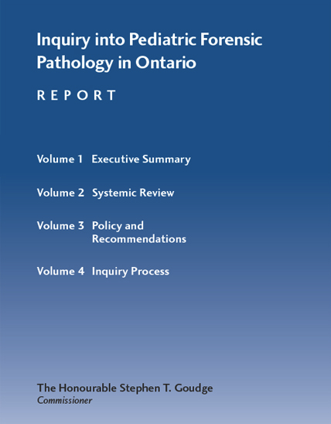
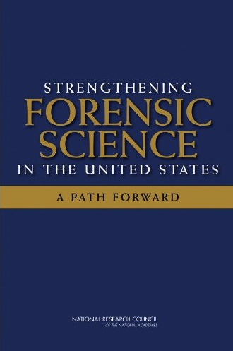
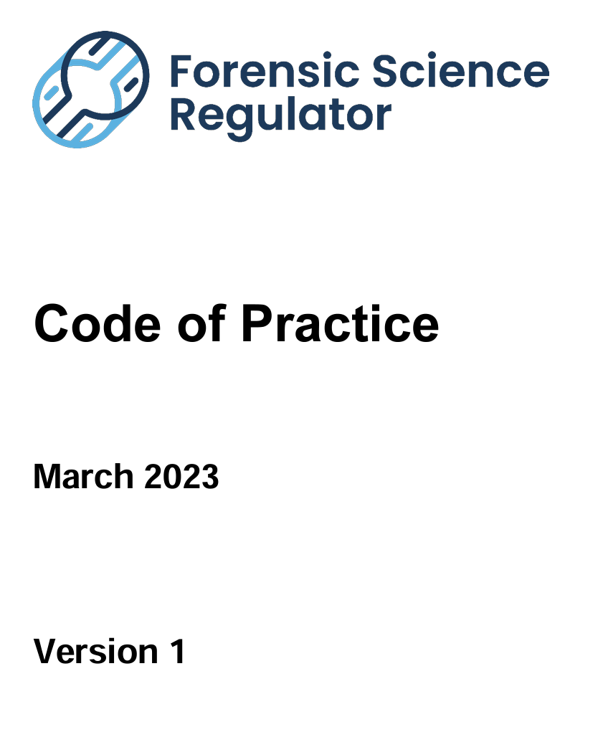
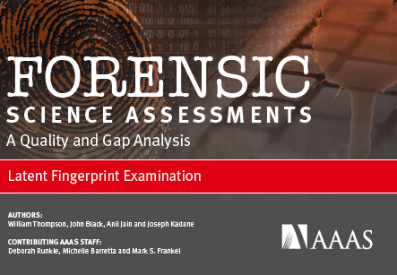
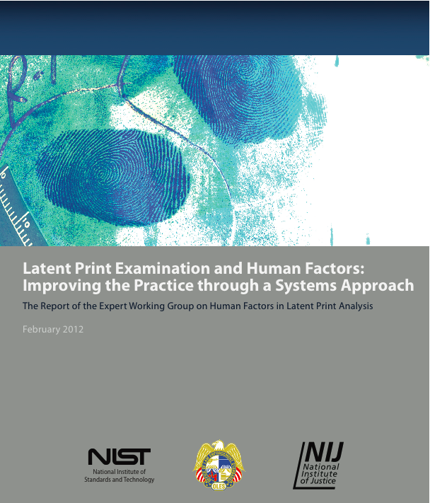
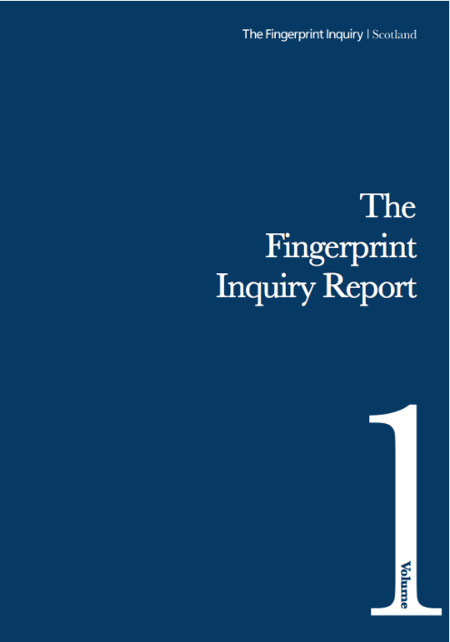
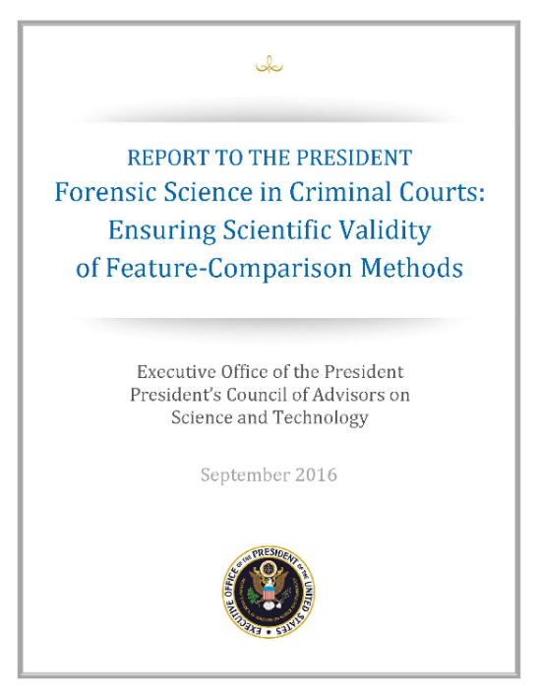
Scientific a
Scientific
‘benchmarks’

Slide 10
Forensic science: Guiding principles
‘Two very important questions should underlie the law’s admission of and reliance upon forensic evidence in criminal trials:
the extent to which a particular forensic discipline is founded on a reliable scientific methodology that gives it the capacity to accurately analyze evidence and report findings and
the extent to which practitioners in a particular forensic discipline rely on human interpretation that could be tainted by error, the threat of bias, or the absence of sound operational procedures and robust performance standards.’
National Academy of Sciences, Strengthening Forensic Science in the United States (2009) (‘NAS’ or ‘NRC’ report)

Slide 11
Validation
‘… valid scientific knowledge can only be gained through empirical testing of specific propositions.’
‘For a metrological method to be scientifically valid and reliable, the procedures that comprise it must be shown, based on empirical studies, to be repeatable, reproducible, and accurate, at levels that have been measured and are appropriate to the intended application.’
‘… methods must be presumed to be unreliable until their foundational validity has been established based on empirical evidence.’
President’s Council of Advisers on Science and Technology, Forensic Science in Criminal Courts (2016) (‘PCAST’)

Slide 12
Validation
‘We distinguish here between two types of scientific validity: foundational validity and validity as applied.
Foundational validity for a forensic-science method requires that it be shown, based on empirical studies, to be repeatable, reproducible, and accurate, at levels that have been measured and are appropriate to the intended application. Foundational validity, then, means that a method can, in principle, be reliable. It is the scientific concept we mean to correspond to the legal requirement, in Rule 702(c), of “reliable principles and methods.”
Validity as applied means that the method has been reliably applied in practice. [For the US Federal Rules of Evidence] it is the scientific concept we mean to correspond to the legal requirement, in Rule 702(d), that an expert “has reliably applied the principles and methods to the facts of the case.”’
PCAST, 4-5.
PCAST, 4-5

Slide 13
Foundational validity
‘The essential points of foundational validity include the following:
Foundational validity requires that a method has been subjected to empirical testing by multiple groups, under conditions appropriate to its intended use. The studies must (a) demonstrate that the method is repeatable and reproducible and (b) provide valid estimates of the method’s accuracy (that is, how often the method reaches an incorrect conclusion) that indicate the method is appropriate to the intended application.
For objective methods, the foundational validity of the method can be established by studying measuring the accuracy, reproducibility, and consistency of each of its individual steps.
For subjective feature-comparison methods, because the individual steps are not objectively specified, the method must be evaluated as if it were a “black box” in the examiner’s head. Evaluations of validity and reliability must therefore be based on “black-box studies,” in which many examiners render decisions about many independent tests (typically, involving “questioned” samples and one or more “known” samples) and the error rates are determined. [significant human judgment]
Without appropriate estimates of accuracy, an examiner’s statement that two samples are similar—or even indistinguishable—is scientifically meaningless: it has no probative value, and considerable potential for prejudicial impact.’
PCAST, 5-6.

Slide 14
Repeatable, reproducible, accurate and reliability
PCAST, 47.

Slide 15
Validity as applied
‘To meet the scientific criteria for validity as applied, two tests must be met:
The forensic examiner must have been shown to be capable of reliably applying the method and must actually have done so. Demonstrating that an expert is capable of reliably applying the method is crucial—especially for subjective methods, in which human judgment plays a central role. From a scientific standpoint, the ability to apply a method reliably can be demonstrated only through empirical testing that measures how often the expert reaches the correct answer. Determining whether an examiner has actually reliably applied the method requires that the procedures actually used in the case, the results obtained, and the laboratory notes be made available for scientific review by others.
The practitioner’s assertions about the probative value of proposed identifications must be scientifically valid. The expert should report the overall false-positive rate and sensitivity for the method established in the studies of foundational validity and should demonstrate that the samples used in the foundational studies are relevant to the facts of the case. Where applicable, the expert should report the probative value of the observed match based on the specific features observed in the case. And the expert should not make claims or implications that go beyond the empirical evidence and the applications of valid statistical principles to that evidence.’
PCAST, 6.

Slide 16
Feature comparison methods
‘A forensic feature-comparison method is a procedure by which an examiner seeks to determine whether an evidentiary sample (e.g., from a crime scene) is or is not associated with a source sample (e.g., from a suspect [or a weapon]) based on similar features. The evidentiary sample might be DNA, hair, fingerprints, bitemarks, toolmarks, bullets, tire tracks, voiceprints, visual images, and so on.’
PCAST, 46

Slide 17
Are feature comparison forensics* valid?
‘With the exception of nuclear DNA analysis, however, no forensic method has been rigorously shown to have the capacity to consistently, and with a high degree of certainty, demonstrate a connection between evidence and a specific individual or source.’
National Academy of Sciences, Strengthening Forensic Science in the United States (2009)
* e.g. latent fingerprint†, shoe, foot, ear, tyre, bite mark, hair, fibre, soil, ballistic, toolmark, handwriting, bloodstain, voice and image comparisons, and so on.
† in 2009, before Ulery et al (2011), Tangen et al (2011).

Slide 18
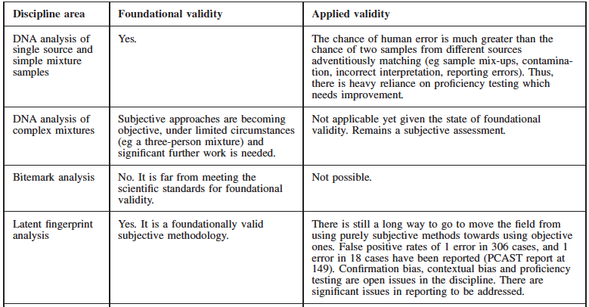
PCAST’s (2016) review of Seven feature comparison methods
1-4:
From Ranson, Cordner and Bassed, (2016) 24 JLM 297
Notes:
[Beyond training and formal qualifications in some cases. Actual ability. CTS inadequate, but might be worth asking for them.

Slide 19
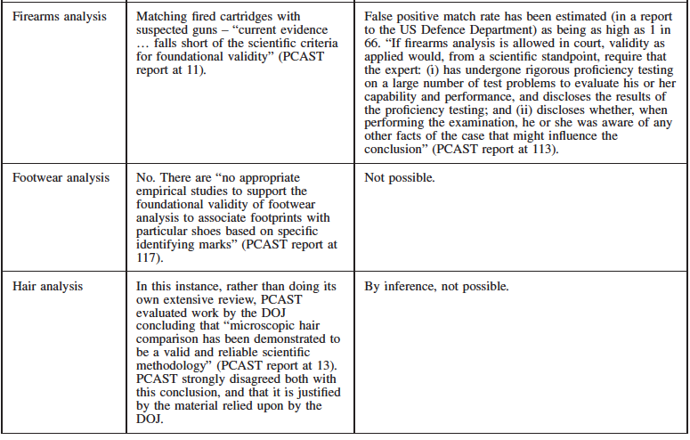
PCAST’s (2016) review of Seven feature comparison methods
5-7:
From Ranson, Cordner and Bassed, (2016) 24 JLM 297
Notes:
[Beyond training and formal qualifications in some cases. Actual ability. CTS inadequate, but might be worth asking for them.

Slide 20
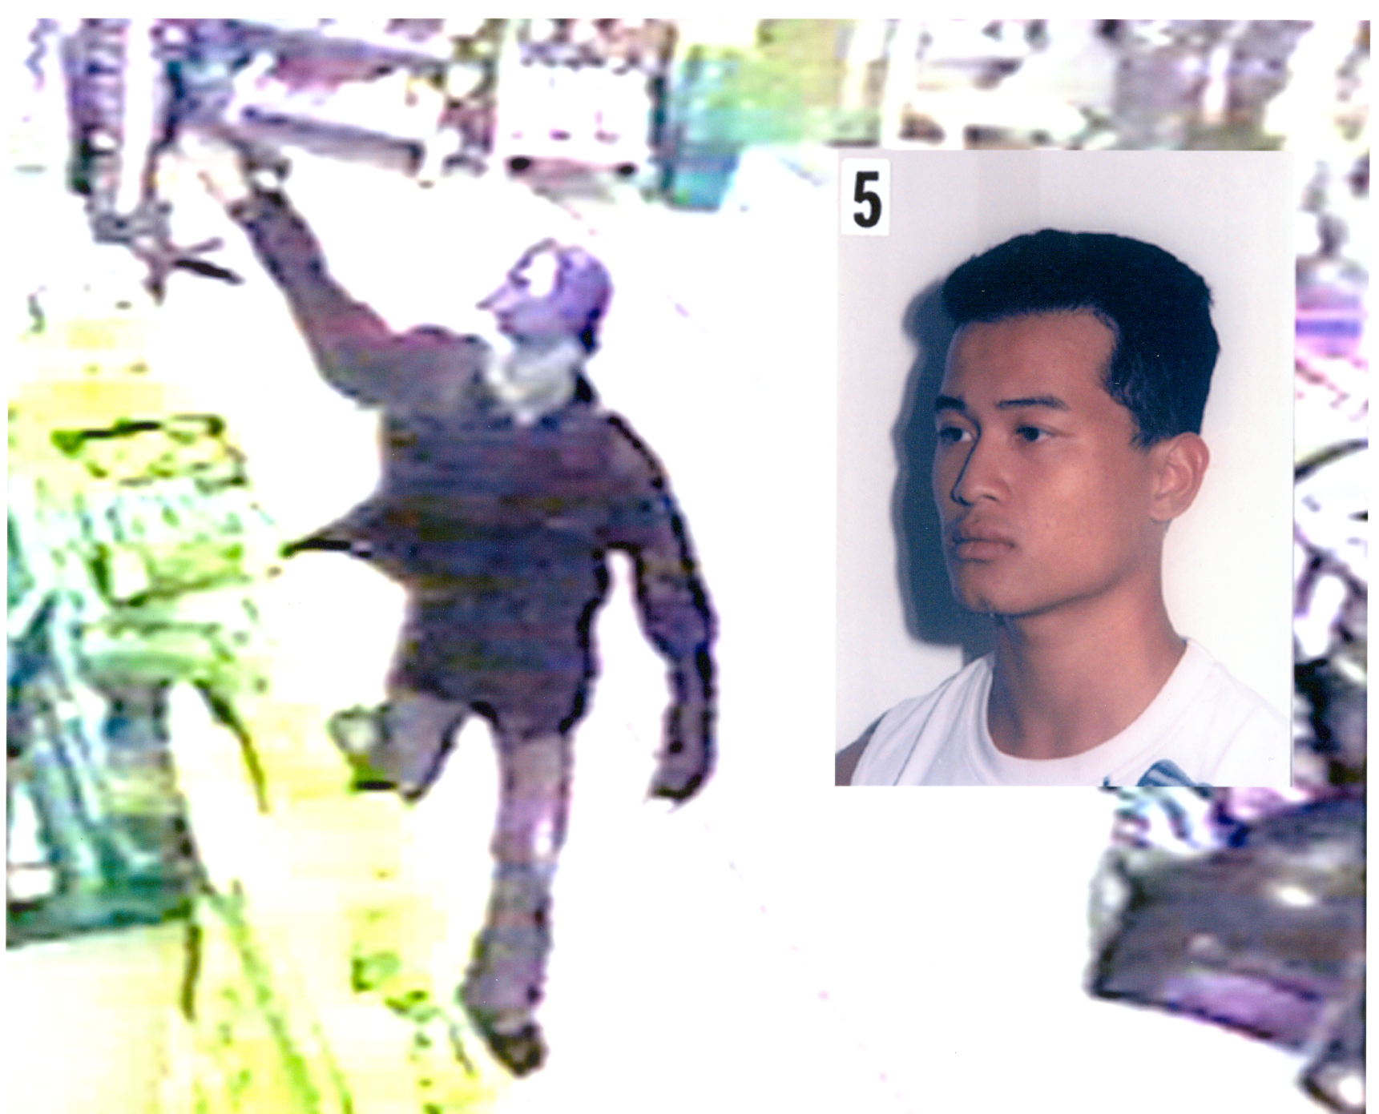
Using image (or facial) comparison as an example
of validation
What do we need?
(yes, it’s a question for you)

Slide 21
Foundational validity of image comparisons (of passport photos)
Ask examiners (participants) to determine whether images are the same person or different persons over and over. (It is imperative that those managing the testing know the correct answers.)
What should the examiners know about the case and what tools, equipment or resources should they have during the testing? (Information relevant to task and, ideally, their normal tools.)
What do the tests reveal and what are their benefits?
What are the limits of such validation studies?
Try the Glasgow Face Match Test (GFMT) online
Notes:
Assumptions about experience. The limits of experience.

Slide 22
A recent validation study of comparisons based on moderate quality images from the ‘wild’
Change of appearance?
Images from social media
A. Towler et al, ‘Diverse types of expertise in facial recognition’ (2023) 23 Sci. Rep. 11396.

Slide 23
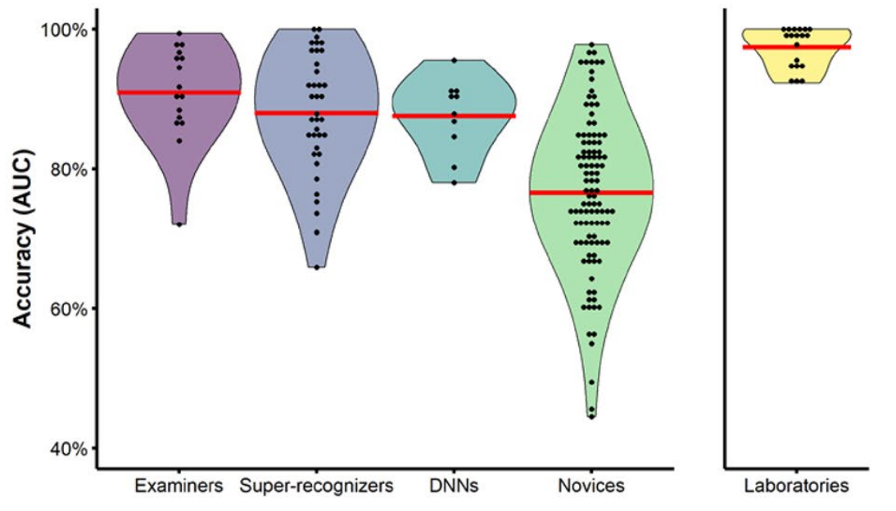
Results of (a) foundational validity study: Who might testify?
DNN – deep neural networks (algorithms)
Novices – ordinary persons
Super-recognisers – persons with superior innate abilities
A. Towler et al, ‘Diverse types of expertise in facial recognition’ (2023) 23 Sci. Rep. 11396.

Slide 24
Some things to consider for validity as applied:
What type of analyst is opining? (Note the variation in performance across the different groups)
What kinds of images being analysed?
Did the analyst apply the method or protocol used by those in the foundational validation study?
And, has the analyst been formally evaluated in conditions where ground truth (ie correct answers) were available to assess accuracy?
Changes to the method or protocol need to be validated (this is ongoing). (Cannot assume that changes will be neutral or positive.)
Did the analyst have access to case (or other task irrelevant) information – i.e. beyond the images, types of camera, types of files, age of images etc. (Can this be managed, or re-done?)
Who is going to hear the opinion and should they also be allowed to examine the images?

Slide 25
Validity as applied (CCTV security images)
Does the foundational validity of the study of photo comparison with medium to good full frontal images apply to comparison and analysis of these images?
What might be required for such comparisons to be foundationally valid and valid as applied?

Slide 26
Standards
‘Often there are no standard protocols governing forensic practice in a given discipline. And, even when protocols are in place, they often are vague and not enforced in any meaningful way. … These shortcomings obviously pose a continuing and serious threat to the quality and credibility of forensic science practice.’
National Academy of Sciences, Strengthening Forensic Science in the United States (2009)

Slide 27
Standards
Is there a specific procedure (ie method or protocol)?
What is it, and was it scrupulously followed? (For example, should features in the ‘unknown’ image – i.e. face – be documented before the reference image is examined and compared?)
Is there an identifiable image quality or set of requirements or features that is required for the comparison? (e.g. does the image need to incorporate the full face, and can the examiner rely on gait or clothing?)
Does image ‘enhancement’ work or matter?
Can examiner access case information?

Slide 28
Accuracy, uncertainty and errors
‘Few forensic science methods have developed adequate measures of the accuracy of inferences made by forensic scientists. All results for every forensic science method should indicate the uncertainty in the measurements that are made, and studies must be conducted that enable the estimation of those values.’
National Academy of Sciences, Strengthening Forensic Science in the United States (2009).

Slide 29
Terminology and expression
‘many terms are used by forensic examiners in reports and in court testimony … Such terms include … “match,” “consistent with,” “identical,” “similar in all respects tested,” and “cannot be excluded as the source of.” … the forensic science disciplines have not reached agreement or consensus on the precise meaning of any of these terms. This imprecision in vocabulary stems in part from the paucity of research’.
National Academy of Sciences, Strengthening Forensic Science in the United States (2009).

Slide 30
Expression of results and accuracy
How should the analyst’s opinion be expressed? (Positive ID, ‘similarities’ or …?)
Expression should be guided by the results of foundational validation studies. These are indicative, but provide an empirically-based framework for expression and evaluation.
The foundational validation studies we have are based on moderate to good quality images, so we should not simply extrapolate to low quality images, for example.
The fact that there may be more individual (analyzable) images in a video may not matter where the method is not foundationally valid – and so ability is uncertain.

Slide 31
Expression of opinion: Mostly conventional (at law)
DNA profiles: statistical (frequentist or likelihood ratios). (Validated – derived from mainstream scientific research)
Latent fingerprints: positive ID (i.e. individualisation). (PV)
Ballistics: individualisation to a specific weapon. (PV)
Incriminating images (e.g. CCTV): Individualisation and similarities. (PV)
Shoe prints: varies, often now framed in Bayesian terms – e.g. strong support. (NV/PV)
Blood spatter and stain interpretation: varies from positive assertions to qualified, but high error rates (NV/PV)
Incriminating voice recordings: individualisation, even across languages. (NV)
Microscopic hair comparison: historically, very similar or the same and cannot exclude (Invalid)
Bite marks: historically individualisation. (Invalid)
V – validated; PV – partially validated; NV – not validated
Notes:
Why the variation? Is the individual an expert? Is there a demonstrably reliable method? What would the individual say if no legal restraints?

Slide 32
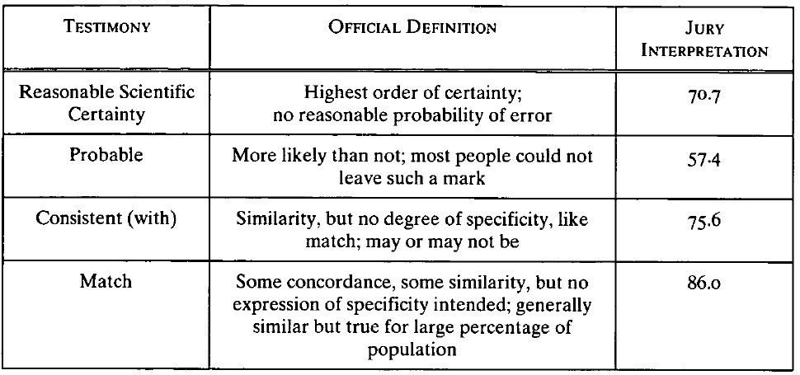
Lay interpretations (of bitemark comparison evidence)
American Board of Forensic Odontology
McQuiston & Saks, (2008) 59 Hastings Law Journal 1159
Notes:
Ignitable liquids standard and a fire examiner indicated to the committee that what they meant by a match was different to what the fingerprint examiners meant. But that the jury understood what they meant.
In the same arson case a jury may well hear evidence about a the presence of ignitable liquids ‘matching’ some profile and a fingerprint on a fuel can that matched the accused, and the jury be expected to know the difference. Things only get more complicated were we to have a bite mark included.
This chart is interesting, because it suggests a disjuncture between the expression and the reception. The lack of validation only accentuates that position.
There is a need for standardisation. And, there is a need for research into jury understadning.
Persoanlly, I think that forensaic scientists should not try to second guess the trial. They should base their expressions on evidence and leave it to the courts to require something different.
Though, forensic scientists should be willing to contest legal responses and should not drop below their empircially-based expressions regardless of what courts allow.

Slide 33
Lay interpretations (of bitemark comparison evidence)
American Board of Forensic Odontology
McQuiston & Saks, (2008) 59 Hastings Law Journal 1159
Notes:
Ignitable liquids standard and a fire examiner indicated to the committee that what they meant by a match was different to what the fingerprint examiners meant. But that the jury understood what they meant.
In the same arson case a jury may well hear evidence about a the presence of ignitable liquids ‘matching’ some profile and a fingerprint on a fuel can that matched the accused, and the jury be expected to know the difference. Things only get more complicated were we to have a bite mark included.
This chart is interesting, because it suggests a disjuncture between the expression and the reception. The lack of validation only accentuates that position.
There is a need for standardisation. And, there is a need for research into jury understadning.
Persoanlly, I think that forensaic scientists should not try to second guess the trial. They should base their expressions on evidence and leave it to the courts to require something different.
Though, forensic scientists should be willing to contest legal responses and should not drop below their empircially-based expressions regardless of what courts allow.

Slide 34
Don’t rely upon bare experience ...
‘We note, finally, that neither experience, nor judgment, nor good professional practices (such as certification programs and accreditation programs, standardized protocols, proficiency testing, and codes of ethics) can substitute for actual evidence of foundational validity and reliability.
…
Similarly, an expert’s expression of confidence based on personal professional experience or expressions of consensus among practitioners about the accuracy of their field is no substitute for error rates estimated from relevant studies. For forensic feature-comparison methods, establishing foundational validity based on empirical evidence is thus a sine qua non. Nothing can substitute for it.’
President’s Council of Advisers on Science and Technology (2016)

Slide 35
‘Experience’ example: Australian passport officers
Notes:
Assumptions about experience. The limits of experience.

Slide 36
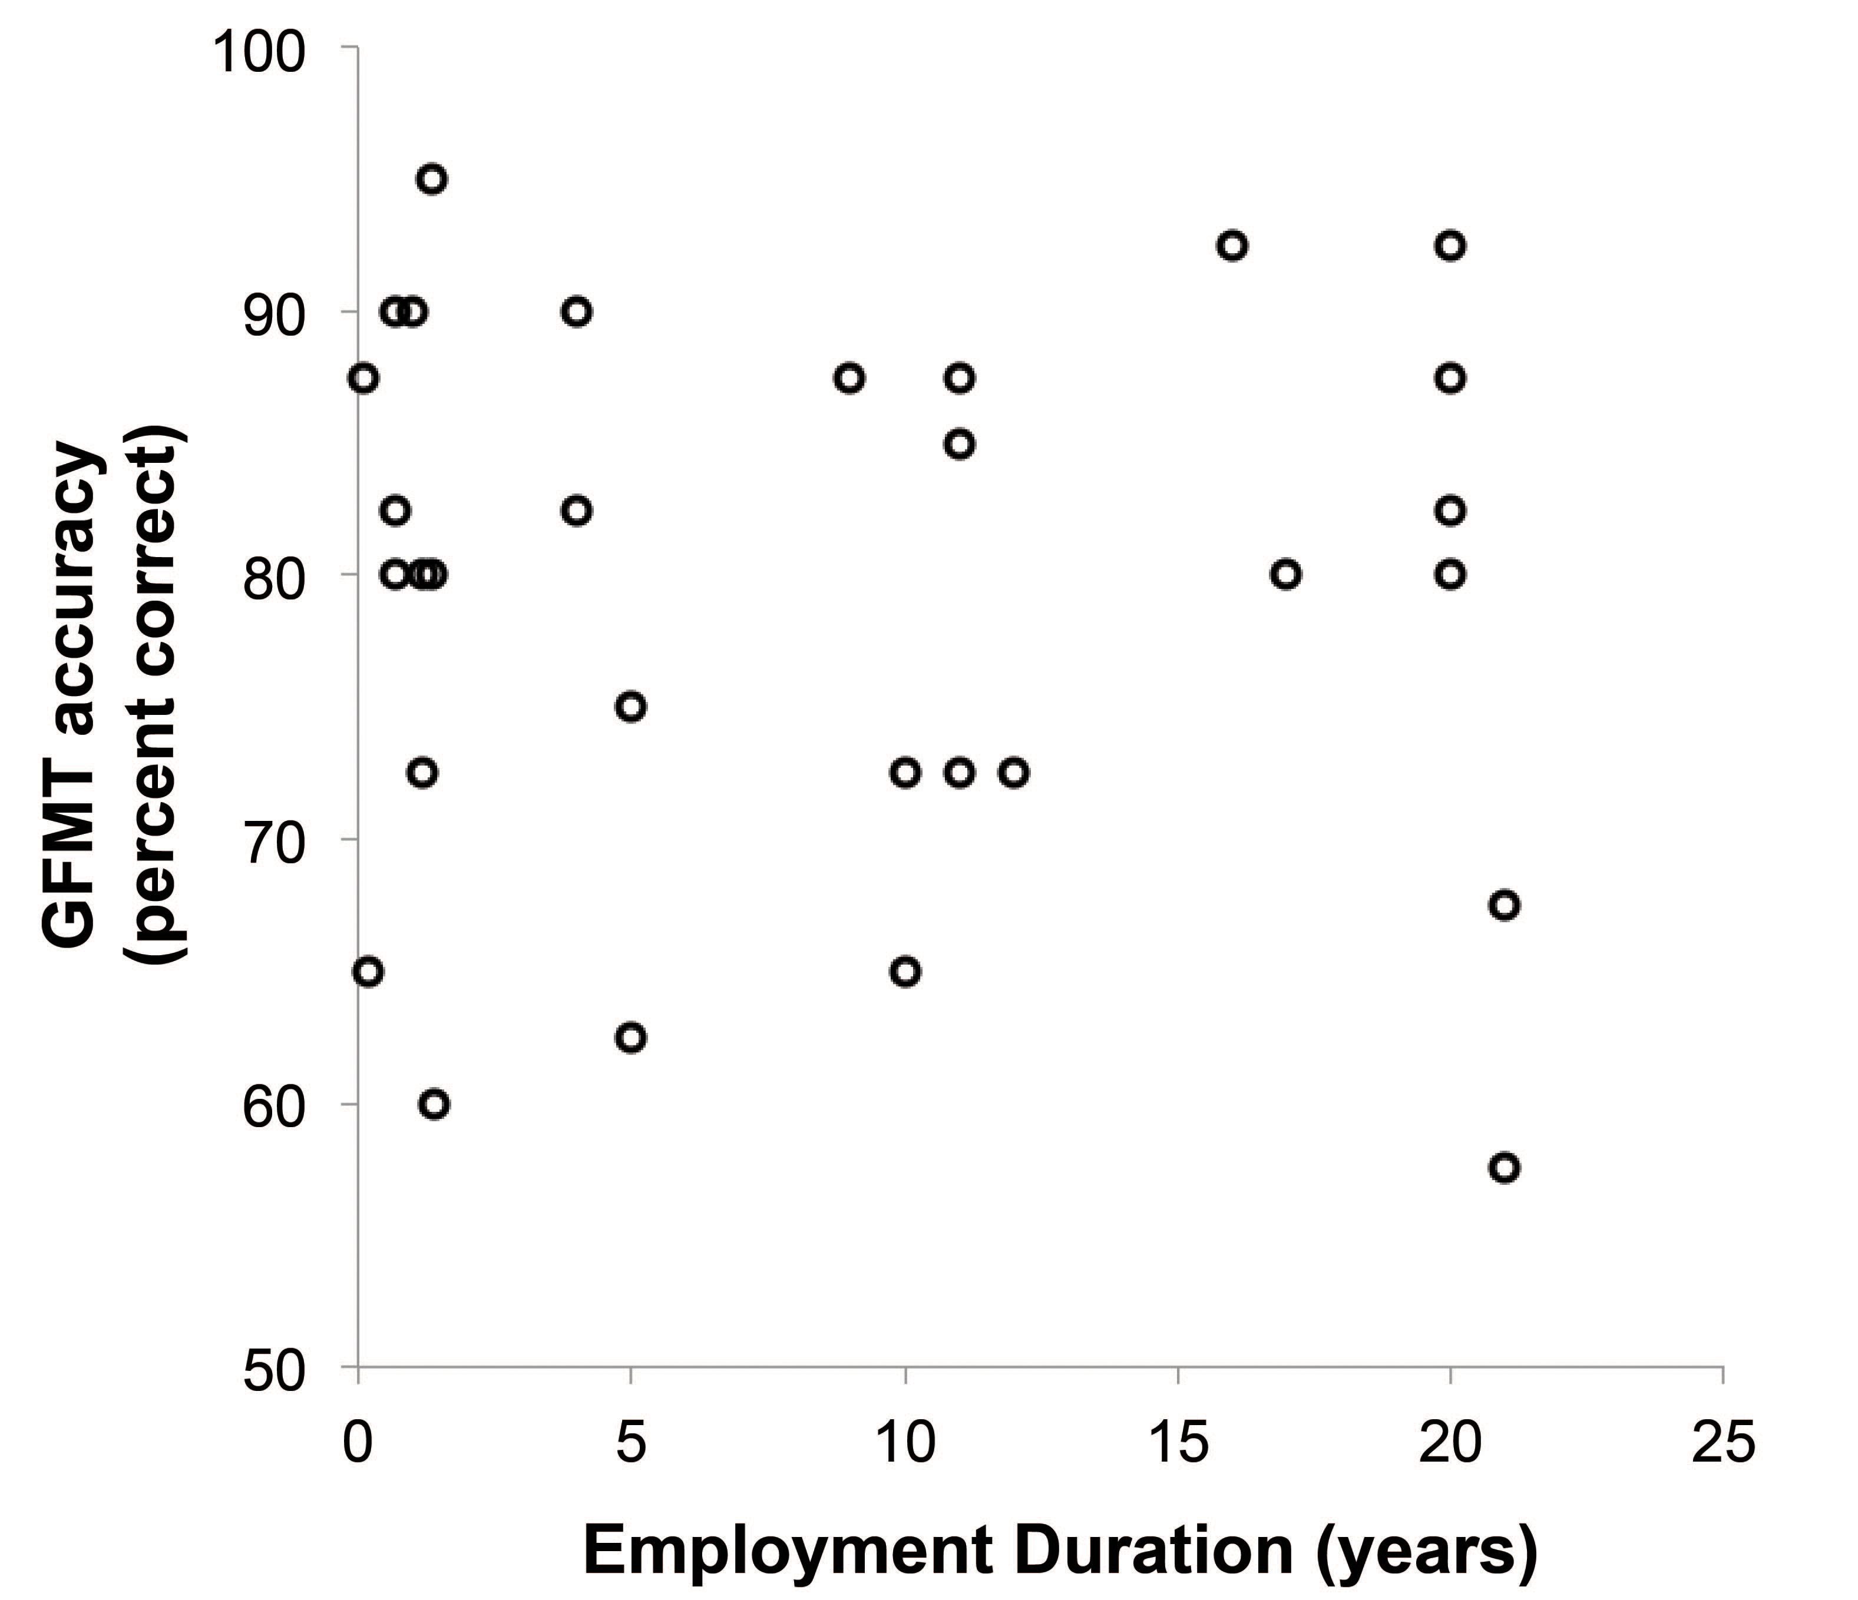
Australian passport officers’ actual abilities
Normative (students):
M = 81.3%; SD = 9.7
Passport Officers:
M = 79.2%; SD = 10.4
White et al. (2014). Passport Officers Errors in face Matching. PLOS ONE 9(8)
Notes:
Assumptions about experience. The limits of experience.

Slide 37
Human factors (especially cognitive biases)
‘Some initial and striking research has uncovered the effects of some biases in forensic science procedures ... The forensic science disciplines are just beginning to become aware of contextual bias and the dangers it poses. The traps created by such biases can be very subtle, and typically one is not aware that his or her judgment is being affected.’
National Academy of Sciences, Strengthening Forensic Science in the United States (2009)
See also
Expert Working Group, Latent Print Examination and Human Factors: Improving the Practice through a Systems Approach (US National Institute of Standards and Technology & National Institute of Justice, 2012);
EBFI, ‘Thinking forensics: Cognitive science for forensic practitioners’ (2017) 57 Science & Justice 144 and ‘Just cognition’ (2019) 82 Modern Law Review 633.
Notes:
Studies by Dror et al.

Slide 38
Human factors (especially cognitive biases)
‘Cognitive bias refers to ways in which human perceptions and judgments can be shaped by factors other than those relevant to the decision at hand. It includes “contextual bias,” where individuals are influenced by irrelevant background information; “confirmation bias,” where individuals interpret information, or look for new evidence, in a way that conforms to their pre-existing beliefs or assumptions; and “avoidance of cognitive dissonance,” where individuals are reluctant to accept new information that is inconsistent with their tentative conclusion. The biomedical science community, for example, goes to great lengths to minimize cognitive bias by employing strict protocols, such as double-blinding in clinical trials.’ PCAST, 2016: 31
There are dangers exposing examiners to information that is not strictly required for their task – eg other evidence, investigator’s suspicions, admissions, other forensic results, race, religion, and socio-economic status and so on. (Validation defines what is required.)
Notes:
Studies by Dror et al.

Slide 39
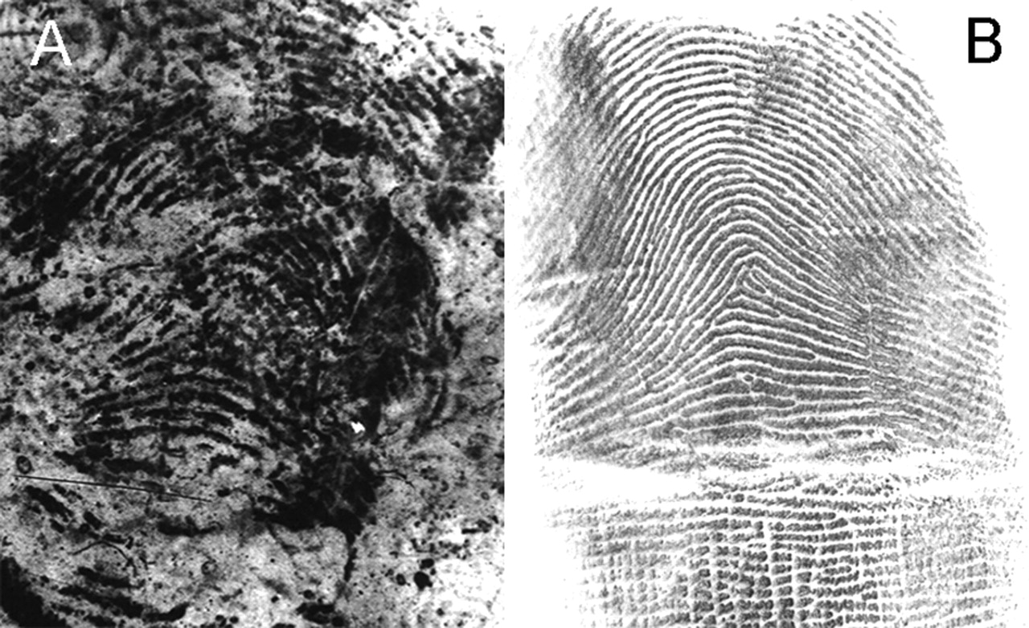
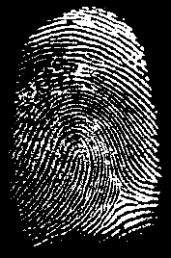
Human factors: a notorious example
Itiel Dror, David Charlton and Ailsa Péron, “Contextual information renders experts vulnerable to making erroneous identifications” (2006) Forensic Science International 174.
For a meta-analysis, see G. Cooper and V. Meterko, ‘Cognitive bias research in forensic science: A systematic review’ (2019) 297 Forensic Science International 35.
Notes:
Studies by Dror et al.

Slide 40
Validation enables the rational evaluation of opinion evidence
Do they have pertinent expertise? Can they do the specific thing? (Rather than do they have general, or apparently relevant, expertise or have they done it before.)
How well can they do it and how do we know? (What studies support the foundational validity of the technique? Were appropriate standards or methods applied in the (case) specific application? What evidence supports this individual being demonstrably proficient? Did other (‘blinded’) proficient analysts agree?)
What form of expression is used and what is it based on? (Is it based on empirical studies with ground truth, or convention, beliefs and speculation?)
How were cognitive biases managed? (How was the analyst shielded from biasing information?)
Does the expert report (statement or disclosure) enable these questions to be answered?

Slide 41
Courts tend to rely on ‘proxies’
(especially when validation studies are not available)
imprecise notions of reliability and validity;
existence of a legally recognised ‘field’ (convention);
use by government institutions and personnel (eg RCMP);
informal moderation of strength of opinions (eg from positive identification to describing similarities);
formal qualifications, job titles and (state) employer;
general training or experience (eg forensic pathology);
whether the method is considered novel or ‘established’;
previous admission (in Canada or elsewhere);
whether opinion considered scientific or non-scientific;
witness partiality and interests;
prima facie plausibility;
whether the opinion is considered to assist the trier of fact; and
availability of defence lawyers, defence experts and other trial safeguards (eg. cross-exam.).

Slide 42
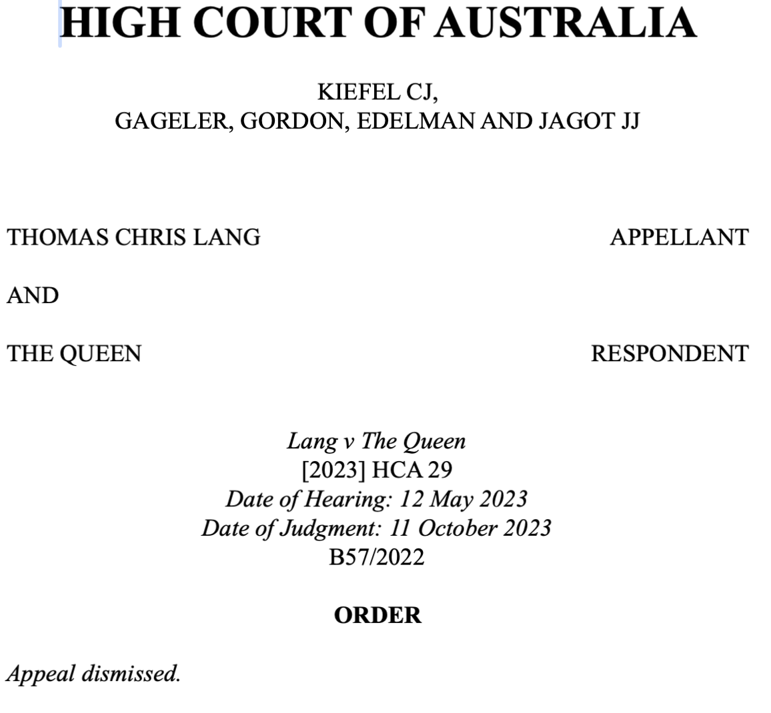
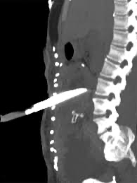
3. An Australian case study

Slide 43
Should a qualified and very experienced forensic pathologist be allowed to express an opinion as to whether a fatal abdominal stab wound was self-inflicted (and so suicide) or inflicted by another person (and so homicide)?
What do you need to know to decide?
Should expression of the opinion in qualified terms – that the wound was ‘more likely’ inflicted by another person than self-inflicted – influence admission?
Does the fact that the forensic pathologist had been to the scene of the crime before conducting the autopsy matter?
Does it matter if the question of who inflicted the wound is the only fact in issue (ie the ultimate issue)?

Slide 44
The Contested opinion and related ‘reasoning’ in testimony
Opinion was said to be based on a ‘whole picture’ analysis, ‘more likely’ homicide because of the following ‘three major factors’ said to be ‘accepted’ by forensic pathologists:
A multiple stab wound: ‘five’ tracks within a single wound, including 180º rotation of blade. ‘In my determination, the—the strongest factor or—or the one that I take most into account is the multiplicity of the stab wounds.’ Pathologist could only find 3 other suicides with multiple tracks inside a wound, and no cases of suicide with partial rotation of the blade.
No prior suicide attempts (e.g. visible scarring) or hesitation wounds, and
Knife piercing the bed sheet then the body (said to slightly support suicide).
(‘I believe these [factors 2 and 3] are not very strong factors to decide one way or another.’)
And, pain (for about 5 seconds of cutting) and the ‘oddness’ of the wound.

Slide 45
Forensic pathologist expressed other opinions – not contested
Deceased died from loss of blood associated with stab wound to the abdomen.
Deceased conscious when wounded.
Deceased conscious and able to move for at least 5 and perhaps 15 minutes before death.
The number (5) and order of blade tracks inside a single entry point.
The stage of rotation or the blade (after 3 insertions) and partial withdrawal.
The first track was said to be fatal.
The position of the body, bent over and lying on side, when knife inserted.
Force required (moderated to mild when Osteoporosis disclosed to forensic pathologist).
Pain experienced by deceased.
Deceased (75kg) capable of fighting-back against (100kg) man.

Slide 46
Other considerations – not addressed by forensic pathologist
The deceased had no defensive injuries.
The deceased did not move, or use the landline telephone on table next to bed, in the minutes she was said to be conscious and mobile.
The deceased’s long history of mental illness and suicidal ideation (said he would have considered if he had known).
No sign of a struggle.
No tidying or clean up of scene.
No blood elsewhere in the apartment or pipes.
Lang’s DNA and fingerprints not on the knife.
Lang’s DNA not found under deceased’s fingernails.
No injuries on Lang.
Not all of these are properly for a forensic pathologist; but there was no attempt to delimit the proper (or evidence-based) scope of forensic pathology opinion.
The witness was asked about these, and may have considered them, but they do not form part of any reporting or reasoning, and are not explained away.

Slide 47
Context and cognitive bias – ‘ignored’ by everyone
What did the pathologist know (and what do they need to know)?
Attended the scene in person and liaised with police.
Conducted autopsy with four police officers in attendance.
Only two persons in the sub-penthouse apartment when death occurred.
Tensions in the relationship, and complex relationship histories (?)
Deceased’s long history of mental illness – including depression, bi-polar disorder and suicidal ideation(?) (but received toxicological report).
Frequency of suicides amongst persons with serious mental illness.
Property on the market but proving difficult to sell (?)
Police and family suspected foul play (?)
Deceased’s phone thrown from balcony after ‘suspicious’ activity around ‘time of death’ (?)
Suspect was a medical doctor (?) and so on …

Slide 48
High court – admissibility of opinion according to Jagot J
‘… it cannot merely be assumed that Dr O, in giving any part of his evidence, was not basing his opinions on his specialist qualifications and work of 25 years as a forensic pathologist. … it must be recalled that that Dr O has worked as a forensic pathologist for some 25 years. He had performed anywhere between about 4,000 to 5,000 autopsies. … Dr O’s opinion as to the likelihood of the fatal wounds being inflicted by another person rather than self‑inflicted was not cloaked “with a spurious appearance of authority”, and thereby did not involve any risk that “legitimate processes of fact‑finding may be subverted”.’ (Lang, [461]-[490])
A ‘shortcut’ from an earlier High Court appeal: Dasreef Pty Ltd v Hawchar
‘The way in which s 79(1) [of the Evidence Act] is drafted necessarily makes [admissibility] requirements very long. But that is not to say that the requirements cannot be met in many, perhaps most, cases very quickly and easily. That a specialist medical practitioner expressing a diagnostic opinion in his or her relevant field of specialisation is applying “specialised knowledge” based on his or her “training, study or experience”, being an opinion “wholly or substantially based” on that “specialised knowledge”, will require little explicit articulation or amplification once the witness has described his or her qualifications and experience …’

Slide 49
With respect to the forensic pathologist’s opinion that it was ‘more likely’ homicide than suicide, what can we say about?
Validation of method or skill: foundational or as applied
Expression – ‘more likely’ homicide
Reasons (or reasoning)
Standards
Uncertainty, limitations and error
Scientific publications – e.g. systematic reviews
Cognitive bias and managing exposure to task (or domain) irrelevant information

Slide 50
Fundamental problems
No lawyer, judge or expert engaged directly with the ability to discriminate between self-inflicted and other knife wounds. (Rebuttal experts tend to disagree on interpretative emphases but not the capabilities of forensic pathologists – Velevski)
‘Method’ not specified or validated.
No specialised knowledge identified. (It may exist, but it was not explicitly engaged).
Interpretation of stab wounds involves pattern recognition: recall NAS and PCAST reports on need for validated methods.
The pathologist’s uncertainty might have been informally embedded in a speculative, admittedly qualified, opinion.
And, no-one asked the all important questions:
Can this pathologist, or any other pathologist, actually do it? How accurately? How do we know?
Without answers to these questions, we do not know if the opinion (and approach) is reliable and it is not possible to rationally evaluate it.

Slide 51
4. Questions and discussion

Slide 52
Trial ‘safeguards’ and expert evidence
Prosecutorial restraint and disclosure
Codes of conduct for experts and rules for expert reports
Admissibility standards (and the common law case of Davey)
Mandatory/discretionary exclusion – probative value versus unfair prejudice to the defendant
Cross-examination
Defence/rebuttal experts
Judicial directions and warnings
Standard and burden of proof
Jury
Appellate review (and post-conviction review)

Slide 53
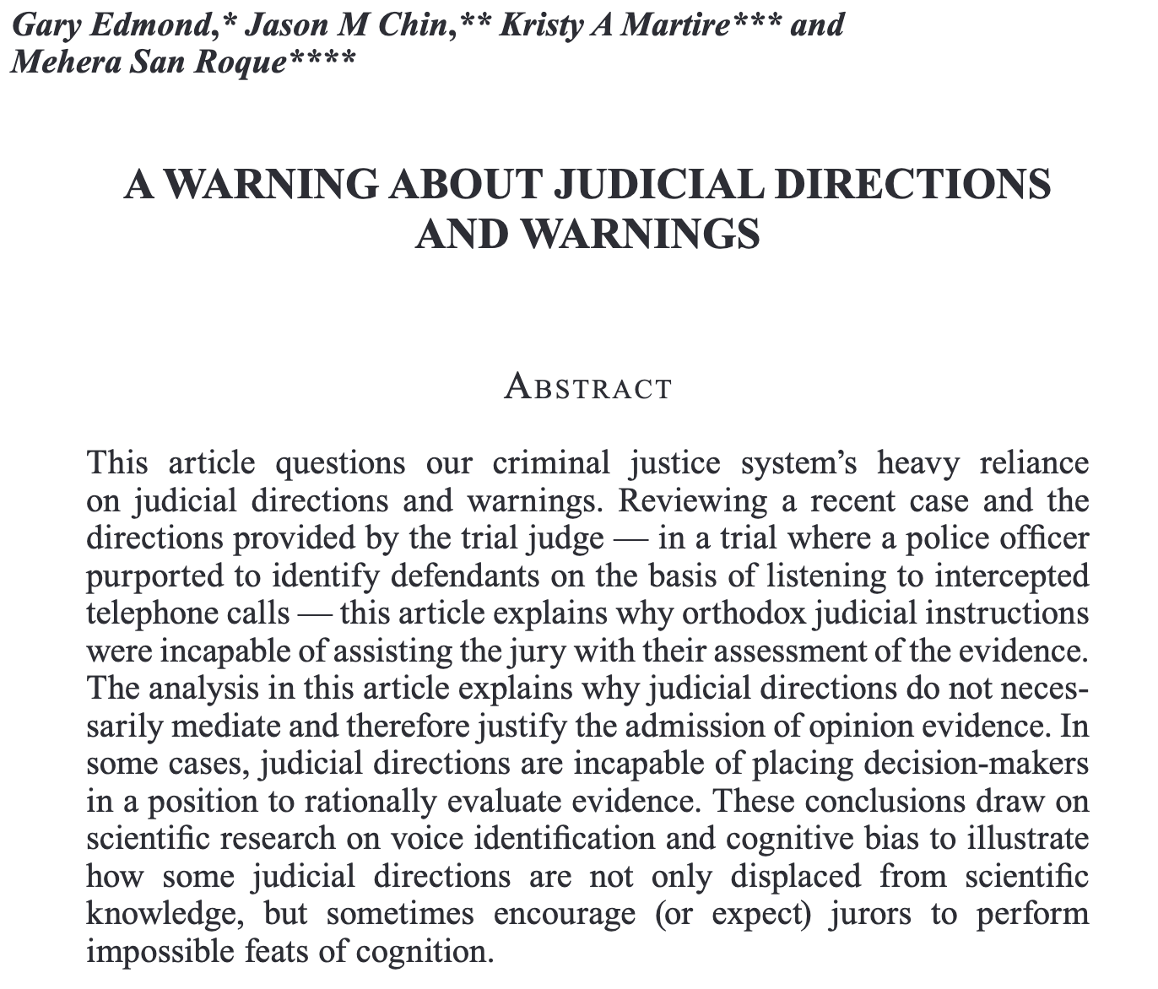
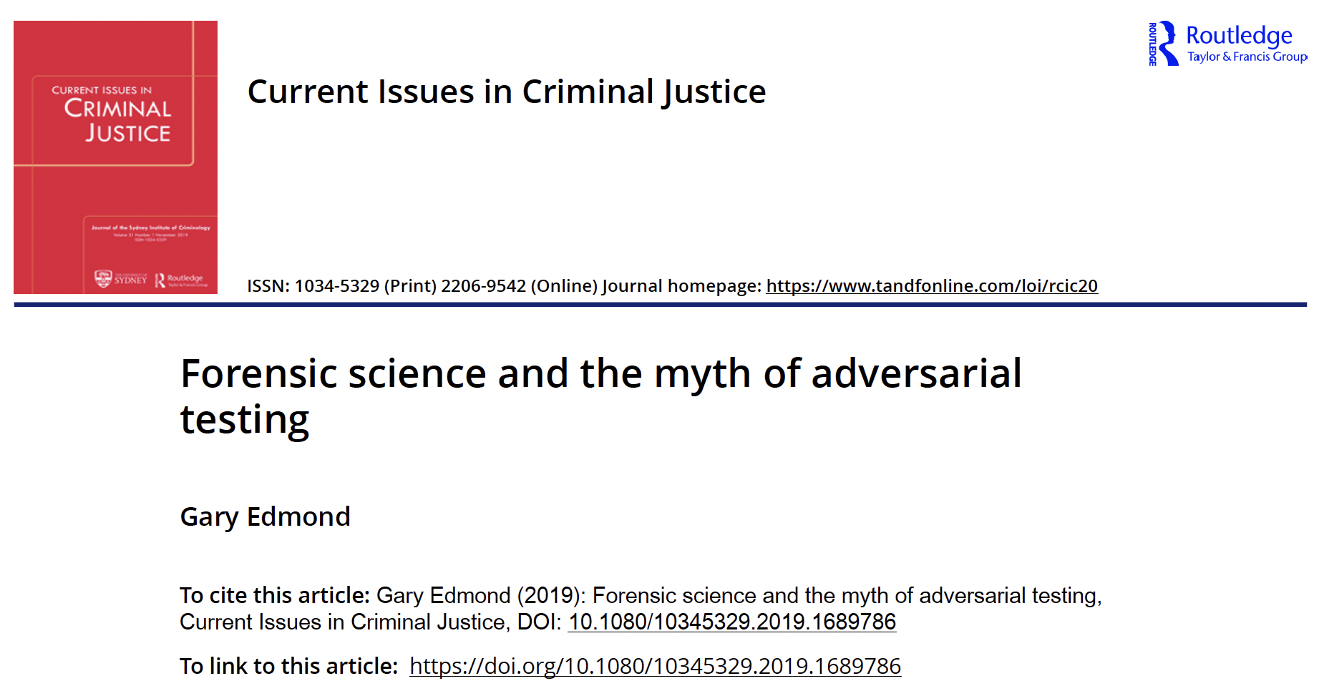
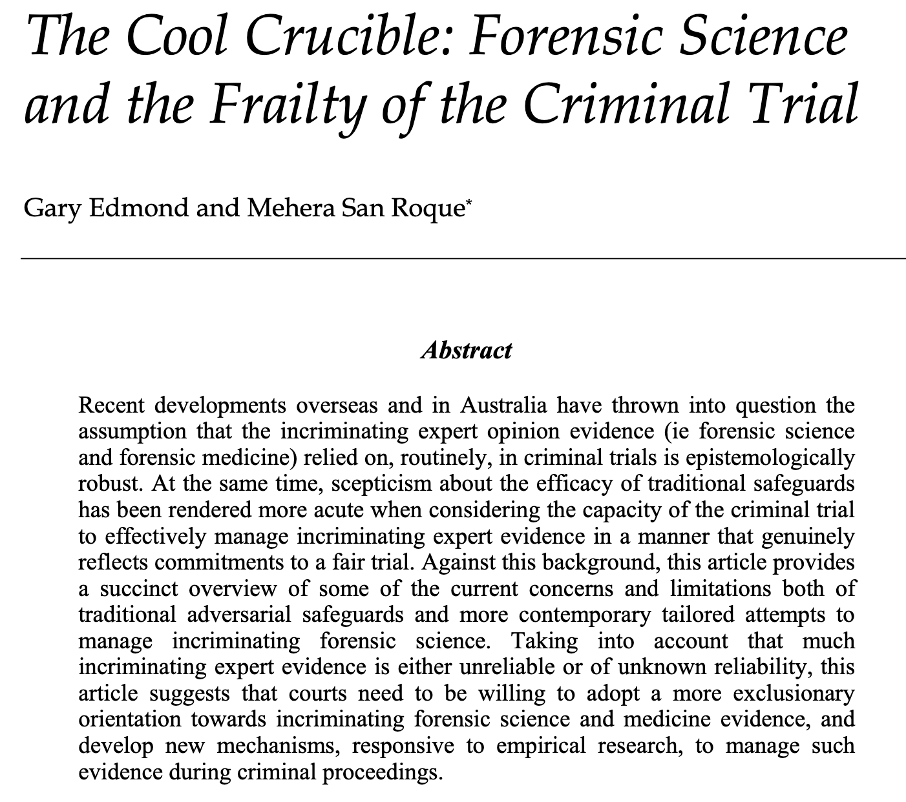
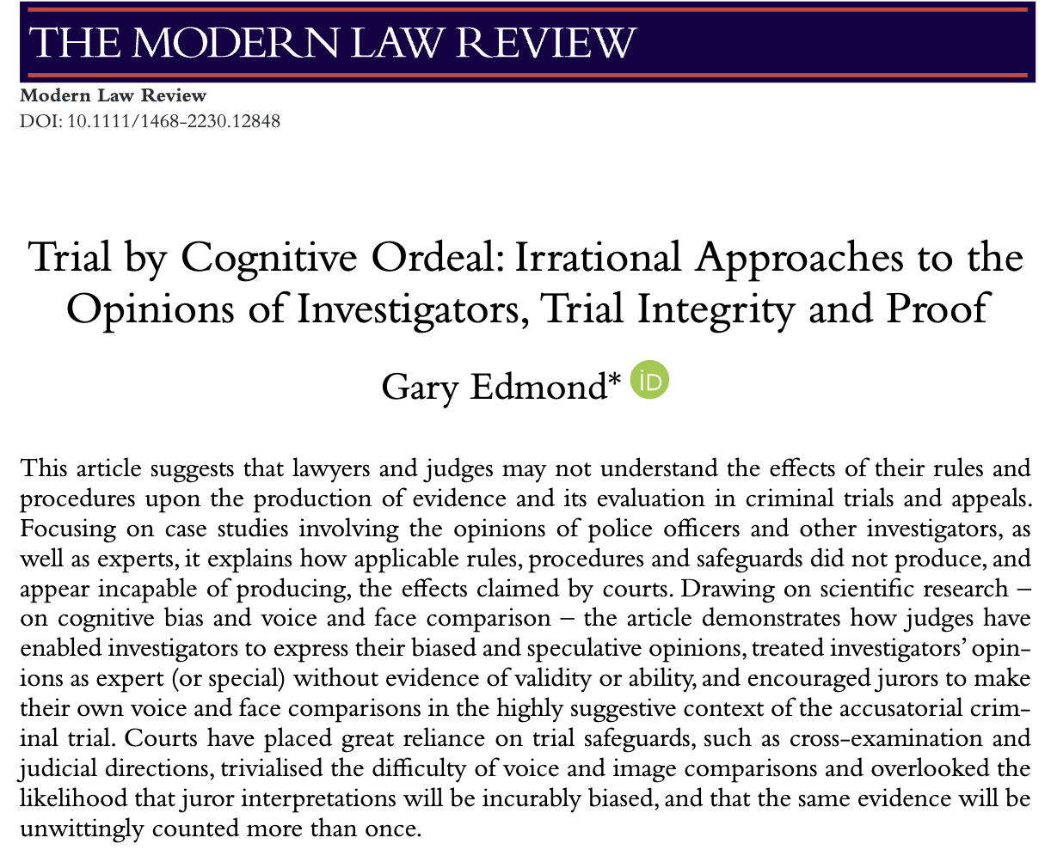
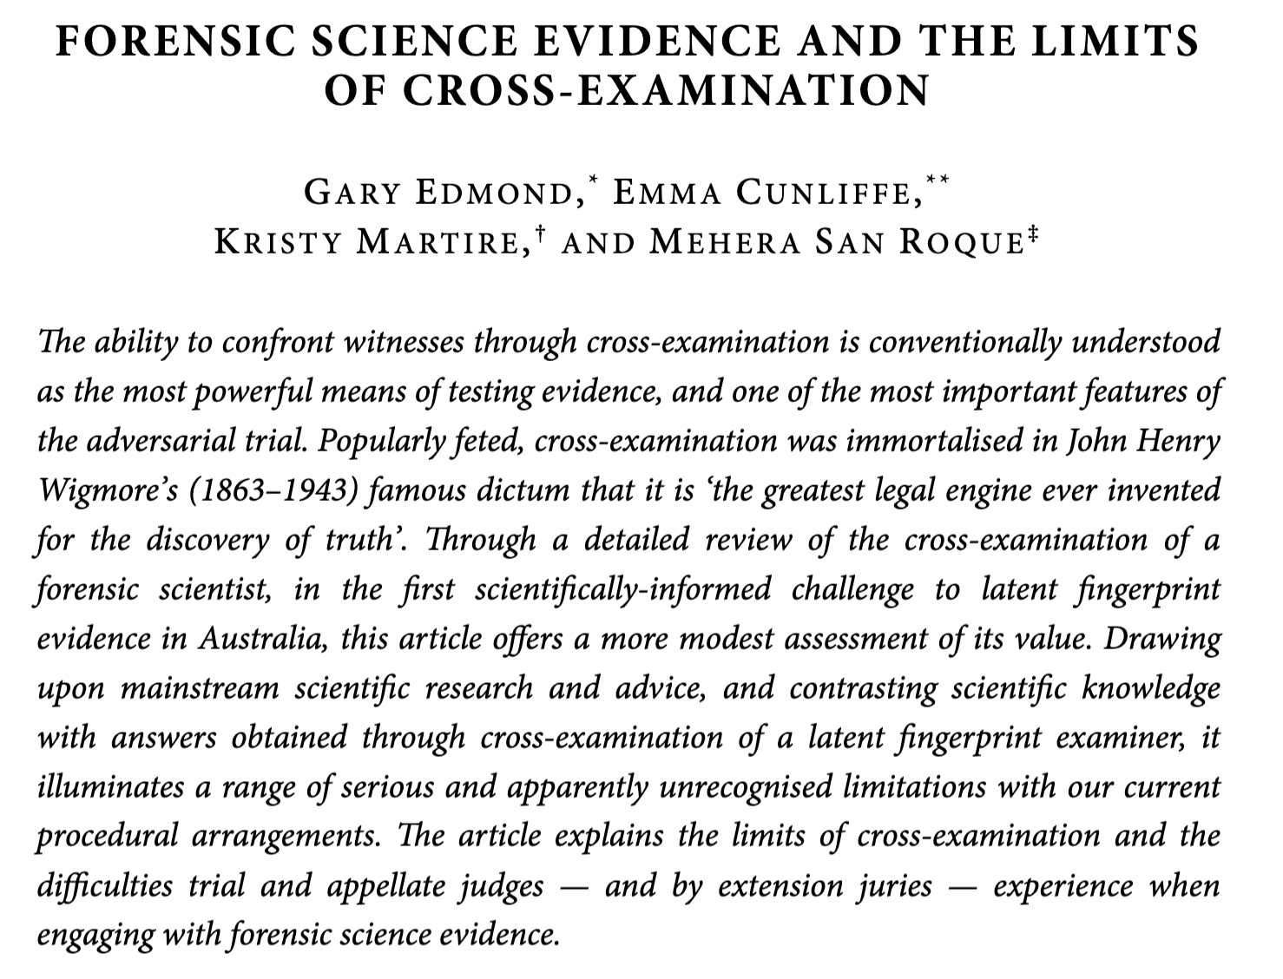
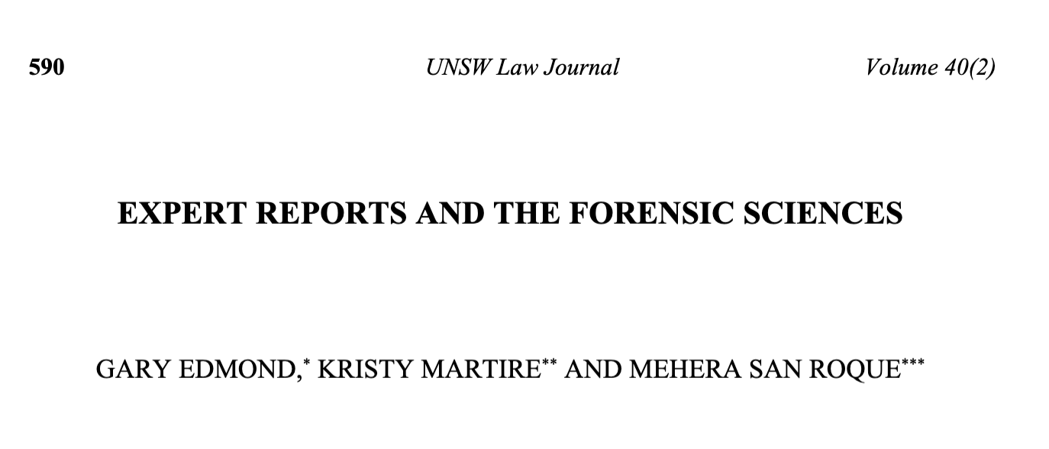
Studies of trial safeguards

Slide 54
Trial ‘safeguards’ and expert evidence
Unlikely to overcome, and may not convey, epistemic difficulties.
Depend on the examiners, the witness, and the trier of fact. For even rigorous, scientifically-informed questioning and submissions may not move some assumptions and beliefs about the value of forensic science evidence.
Trial safeguards cannot substitute for validation studies. At best, they might show that insufficient study has been done, but that does not enable opinions – not based on knowledge – to be rationally evaluated.

