Slide 1

Identifying Expert Opinions &
Evaluating Expert Facts
Prof. Palma Paciocco, Osgoode Hall Law School of York University
Criminal law scholar series | November 2024

Slide 2
Acknowledgments
Thank you to the Courthouse Libraries of British Columbia
This presentation draws on research supported by the Social Sciences and Humanities Research Council
Research assistance was provided by Kevin Chan

Slide 3
Presentation Overview
Research context
Opinion evidence (a quick refresher)
The evolving expert opinion test, and a growing misalignment
“Specialized”/expert factual evidence after Hamilton

Slide 4
research context

Slide 5
EPISTEMIC & NON-EPISTEMIC VALUES
“Ensuring efficiency does not mean sacrificing the rules of evidence” (R. v. Samaniego, 2022 SCC 9 at para. 24)
“Trial judges should tread carefully before imposing requirements for expert evidence. Expert evidence is expensive and complicates proceedings. Further, the concerns regarding its misuse are well-established.” R. v. Milani, 2021 ONCA 567 at para. 73, per Nordheimer J.A. (dissenting, but not on this point)

Slide 6
Two distinct questions…
Do we require the expert opinion evidence?
  Classification of evidence is not in dispute; it is expert opinion
  Admissibility of evidence is in dispute, e.g., on grounds of relevance, necessity…
  Alternatives may include judicial notice, jury instruction, no evidence on this point…
Is the evidence expert opinion?
  Classification of evidence is in dispute; it may or may not be expert opinion
  Admissibility of evidence is (usually) in dispute – but what standard applies?
  Alternatives may include treating as factual evidence, assessing it as lay opinion...

Slide 7
 | LAY EVIDENCE | EXPERT EVIDENCE
FACTUAL (OBSERVATIONAL) EVIDENCE | LAY FACTUAL EVIDENCE Presumptively admissible | EXPERT FACTUAL EVIDENCE/ “SPECIALIZED WITNESS” Not entirely settled; authority treats as presumptively admissible. See esp. R v Hamilton, 2011 ONCA 399 (leave to SCC ref'd, [2011] SCCA No. 547), R v Cyr, 2012 ONCA 919)
OPINION EVIDENCE | LAY OPINION EVIDENCE Presumptively inadmissible; Apply lay opinion evidence rule (Graat) | EXPERT OPINION EVIDENCE Presumptively inadmissible; Apply expert opinion evidence rule (White Burgess; Mohan Factors)

Slide 8
Opinion evidence
(A quick refresher)

Slide 9

Fact vs. opinion – a tenuous distinction

Slide 10
Fact vs. opinion – a tenuous distinction
“Except for the sake of convenience there is little, if any, virtue, in any distinction resting on the tenuous, and frequently false, antithesis between fact and opinion. The line between “fact” and “opinion” is not clear.”
(R. v. Graat, [1982] 2 SCR 819 at p. 835)

Slide 11
Presumption of inadmissibility
“Witnesses are to testify as to the facts which they perceived, not as to the inferences — that is, the opinions — that they drew from them… it is ‘for the jury to form opinions, and draw inferences and conclusions, and not for the witness’.”
(White Burgess Langille Inman v Abbott and Haliburton Co, 2015 SCC 23 at para. 14)

Slide 12
Fact vs. opinion – a Distinction
“An opinion has been defined as an inference, deduction, impression, or conclusion drawn from an observed or presumed fact(s).”
(R v Ottertail, 2018 ABQB 920 at para. 16; R v Abbey, [1982] 2 SCR 24, 42)

Slide 13
 | LAY EVIDENCE | EXPERT EVIDENCE
FACTUAL (OBSERVATIONAL) EVIDENCE | LAY FACTUAL EVIDENCE Presumptively admissible | EXPERT FACTUAL EVIDENCE/ “SPECIALIZED WITNESS” Not entirely settled; authority treats as presumptively admissible. See esp. R v Hamilton, 2011 ONCA 399 (leave to SCC ref'd, [2011] SCCA No. 547), R v Cyr, 2012 ONCA 919)
OPINION EVIDENCE | LAY OPINION EVIDENCE Presumptively inadmissible; Apply lay opinion evidence rule (Graat) | EXPERT OPINION EVIDENCE Presumptively inadmissible; Apply expert opinion evidence rule (White Burgess; Mohan Factors)

Slide 14
Lay Opinion Evidence
“Non-expert witnesses may offer their observations in the form of opinion where:
they are in a better position than the trier of fact to form a conclusion;
the conclusion is one that a lay person can make;
the witness has the necessary experience to draw the conclusion; and
the opinion is a ‘compendious mode of stating facts that are too subtle or complicated to be narrated as effectively without resort to conclusions.’”
(Canada (Attorney General) v Mosaic Forest Management Corporation, 2022 FCA 216 at para. 17, citing David M Paciocco, Palma Paciocco & Lee Stuesser, The Law of Evidence, 8th ed (Toronto: Irwin Law, 2020) at 239)

Slide 15
Lay Opinion Evidence
“Courts now have greater freedom to receive lay witness’s opinions if:
The witness has personal knowledge of observed facts
The witness is in a better position than the trier of fact to draw the inference;
the witness has the necessary experience to draw the inference, that is, to form the opinion; and
the opinion is a compendious mode of speaking and the witness could not as accurately, adequately, or with reasonable facility describe the facts she or he is testifying about.’”
(Ganges Kangro Properties Ltd. V. Shepard, (2015) BCAC 269, [2015] BCJ No 2821 at para. 73, citing Bryant, Lederman & Fuerst, The Law of Evidence in Canada (Markham, ON: LexisNexis Canada, 2014) at 774)

Slide 16
Lay Opinion Evidence
Sopinka, Lederman, Bryant, Fuerst & Stewart | Paciocco, Paciocco & Steusser
Personal knowledge of observed facts | Own observation
Better position than trier of fact to draw inference | Better position than trier of fact to form conclusion
Necessary experience to draw inference | Necessary experience to form conclusion
Opinion is compendious mode of speaking and witness could not as accurately, adequately, or with reasonable facility describe facts | Opinion is compendious mode of stating facts that are too subtle or complicated to be narrated without resort to conclusions
 | Conclusion is one a lay person can make

Slide 17
Opinion Evidence (?)
The robber looked to be in his 20s or 30s.
Her breath smelled of alcohol.
The car accelerated after the light turned yellow.
The cause of death was pulmonary embolism attributed to cocaine-related thrombotic cascade involving both arterial and venous circulations, precipitated by the deceased’s drug-use.
Methamphetamine induces potent vasodilation that can result in myocardial ischemia.

Slide 18

 | EXPERT EVIDENCE
FACTUAL (OBSERVATIONAL) EVIDENCE | EXPERT FACTUAL EVIDENCE/ “SPECIALIZED WITNESS” Not entirely settled; authority treats as presumptively admissible.
OPINION EVIDENCE | EXPERT OPINION EVIDENCE Presumptively inadmissible; Apply expert opinion evidence rule (White Burgess; Mohan Factors)
“Except for the sake of convenience there is little, if any, virtue, in any distinction resting on the tenuous, and frequently false, antithesis between fact and opinion. The line between “fact” and “opinion” is not clear.”
(R. v. Graat, [1982] 2 SCR 819 at p. 835)

Slide 19
Dangers of expert evidence
Expert evidence may lack reliability due to…
  Expert bias/lack of independence
  Expert’s lack of skill/knowledge
  Unreliability of underlying science (‘junk science’)
Lack of reliability can be hard to detect because…
  Hard to cross-examine experts effectively
  Hard to critically evaluate expert evidence
3. “Contest of experts” can be distracting, time-consuming, expensive

Slide 20
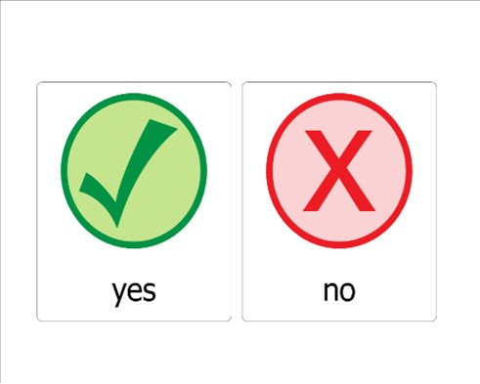
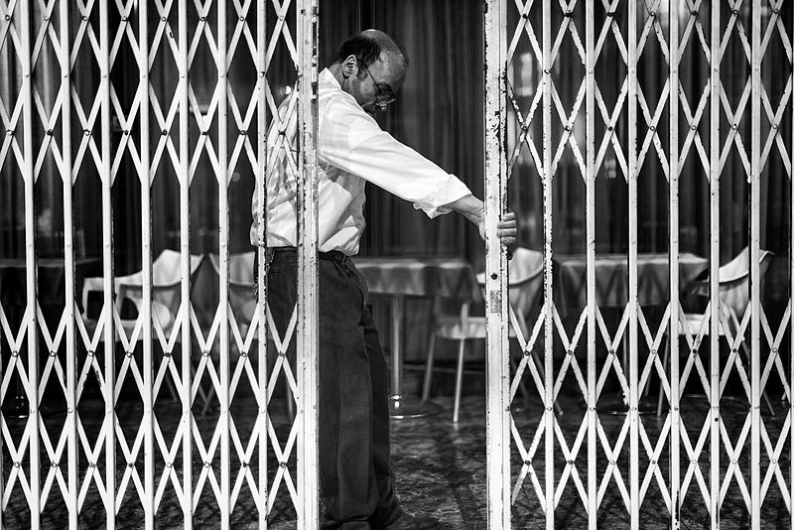
White BurgeSs
Preconditions of Admissibility Discretionary Gatekeeping Stage
Logical Relevance
Necessity
No Exclusionary Rule
Qualified Expert
[Reliability of Underlying Science for the Purpose (for novel/contested science)]

Slide 21
NECESSITY
“[T]he necessity requirement exists ‘to ensure that the dangers associated with expert evidence are not lightly tolerated’ and that ‘[m]ere relevance or ‘helpfulness’ is not enough’” (White Burgess at para. 21)
“[E]xpert evidence must be necessary in order to allow the fact finder:
  to appreciate the facts due to their technical nature, or;
  to form a correct judgment on a matter if ordinary persons are unlikely to do so without the assistance of persons with special knowledge.”
  (R v DD, 2000 SCC 43 at para. 47. citing Sopinka, Lederman & Bryant, The Law of Evidence in Canada (2nd ed. 1999) at p. 620, citing Mohan at p. 23).

Slide 22
Properly Qualified Expert
Knowledge & expertise
  Special knowledge/experience beyond ken of average juror
  Formal study/training not required, may go to weight
  Knowledge must be acquired through systematic learning
Independence & impartiality
  Expert is able and willing to carry out their primary duty to the court

Slide 23
Reliability of Underlying Science
Novel or Contested Science:
  Necessity requirement stricter: evidence must be “essential in the sense that the trier of fact will be unable to come to a satisfactory conclusion without the assistance of the expert” (R v J.(J.-L.), 2000 SCC 51 at para. 35)
  Special scrutiny of reliability: stricter as evidence approaches ultimate issue (Mohan)
    “Hard Sciences” – R v J.-L.J., [2000] 2 SCR 600, para. 33 (Daubert factors)
    “Soft Sciences” – R v Abbey, 2009 ONCA 624, para. 119
    “Goudge factors” – see Kolapully v Myles, 2024 ONCA 350, para. 17

Slide 24
Discretionary Gatekeeping Stage
Is the evidence “sufficiently beneficial to the trial process to warrant its admission despite the potential harm to the trial process that may flow from the admission of the expert evidence”?
Exclude if prejudicial effect outweighs probative value (or, for defence evidence, substantially outweighs)
Consider:
  Legal relevance
  Necessity
  Reliability
  Absence of bias

Slide 25
White BurgeSs
Preconditions of Admissibility Discretionary Gatekeeping Stage
Logical Relevance
Necessity
No Exclusionary Rule
Qualified Expert
[Reliability of Underlying Science for the Purpose (for novel/contested science)]

Slide 26
LAY VS. EXPERT – a vital distinction
“It is vitally important to keep lay opinion evidence distinct from expert opinion evidence, because the road to admissibility for expert opinion evidence has become increasingly stringent. If courts do not carefully differentiate between the two, there is a danger that expert opinion evidence will be admitted as lay opinion evidence, without being subject to the heightened expert opinion requirements delineated in the case law and the notice provisions…”
(R v Sutherland, 2022 MBCA 23 at para. 39)

Slide 27
LAY VS. EXPERT
Focus on nature of opinion, not who is offering it.
Key question: “Whether the opinion could be formed only by someone with special training or expertise, which is expert opinion evidence, or whether the opinion is based on ordinary experience, making it lay opinion.”

Slide 28
 | LAY EVIDENCE | EXPERT EVIDENCE
FACTUAL (OBSERVATIONAL) EVIDENCE | LAY FACTUAL EVIDENCE Presumptively admissible | EXPERT FACTUAL EVIDENCE/ “SPECIALIZED WITNESS” Not entirely settled; authority treats as presumptively admissible. See esp. R v Hamilton, 2011 ONCA 399 (leave to SCC ref'd, [2011] SCCA No. 547), R v Cyr, 2012 ONCA 919)
OPINION EVIDENCE | LAY OPINION EVIDENCE Presumptively inadmissible; Apply lay opinion evidence rule (Graat) | EXPERT OPINION EVIDENCE Presumptively inadmissible; Apply expert opinion evidence rule (White Burgess; Mohan Factors)

Slide 29
The evolving expert opinion test; a growing misalignment

Slide 30
Exclusionary rules: typical structure
Presumption of Inadmissibility | Rationale: category of evidence carries specific danger(s)
Exception(s) whereby evidence can gain admission | Rationale: subcategory of evidence with additional features that neutralize or outweigh specific danger(s)
  Hearsay (reliability)
  Prior consistent statements (relevance)
  Bad character evidence rule (moral & reasoning prejudice)
  Sexual history (myths & stereotypes; privacy and dignity interests)
  Privilege (probative value outweighed by competing values)

Slide 31
Opinion evidence: Rationale for Presumptive inadmissibility
“Witnesses are to testify as to the facts which they perceived, not as to the inferences — that is, the opinions — that they drew from them… it is ‘for the jury to form opinions, and draw inferences and conclusions, and not for the witness’.”
(White Burgess Langille Inman v Abbott and Haliburton Co, 2015 SCC 23 at para. 14)

Slide 32
Lay opinion: typical structure
Presumption of Inadmissibility | Rationale: role distribution – witness states facts, judge/jury draws inferences
Exception(s) whereby evidence can gain admission | Rationale: witness cannot state facts effectively without resort to inferences; witness better-placed than judge/jury

Slide 33
Expert opinion: a growing misalignment
Presumption of Inadmissibility | Rationale: role distribution – witness states facts, judge/jury draws inferences
Exception(s) whereby evidence can gain admission | Rationale: necessity [aligned] reliability [not aligned]

Slide 34
A growing focus on reliability
“Since at least the mid-1990s, the Court has responded to a number of concerns about the impact on the litigation process of expert evidence of dubious value. The jurisprudence has clarified and tightened the threshold requirements for admissibility, added new requirements in order to assure reliability, particularly of novel scientific evidence, and emphasized the important role that judges should play as “gatekeepers” to screen out proposed evidence whose value does not justify the risk of confusion, time and expense that may result from its admission.”
(White Burgess at para 16)

Slide 35
 | EXPERT EVIDENCE
FACTUAL (OBSERVATIONAL) EVIDENCE | EXPERT FACTUAL EVIDENCE/ “SPECIALIZED WITNESS” Not entirely settled; authority treats as presumptively admissible.
OPINION EVIDENCE | EXPERT OPINION EVIDENCE Presumptively inadmissible; Apply expert opinion evidence rule (White Burgess; Mohan Factors)

Slide 36
Fact vs. opinion – Little virtue?
Opinion | The car was very rusty and dented.
Fact | I was standing at the intersection when I saw the car.
Fact or Opinion? | The car accelerated after the light turned yellow.

Slide 37
Fact vs. opinion – Vital distinction?
Opinion | The car was very rusty and dented. | The cause of death was pulmonary embolism attributed to cocaine-related thrombotic cascade involving both arterial and venous circulations, precipitated by the deceased’s drug-use.
Fact | I was standing at the intersection when I saw the car. | Methamphetamine induces potent vasodilation that can result in myocardial ischemia.
Fact or Opinion? | The car accelerated after the light turned yellow. | The deceased’s venous thrombosis precipitated by his cocaine use indicates a greater likelihood that the cocaine he ingested was adulterated with a vasodilating substance such as methamphetamine.

Slide 38
“Specialized”/expert factual evidence after Hamilton

Slide 39
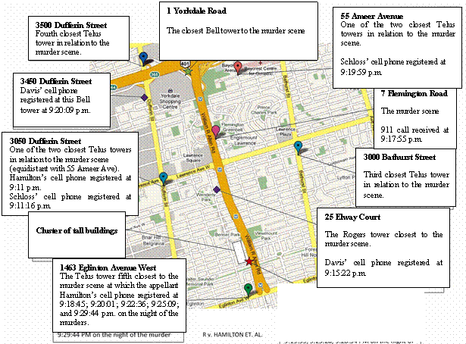
Early cases: Cellphone tower data
R v Hamilton, 2011 ONCA 399 (leave to SCC ref'd, [2011] SCCA No. 547)
R v Cyr, 2012 ONCA 919
Notes:
Hamilton = four accused tried for attempted murder and two counts of first degree murder
Sole issue was identity
Crown evidence included cell phone records from the accused, as circumstantial evidence of their movements – the idea being that the location of the towers where their cellphones registered or ‘pinged’ could help identify their location at the time of the murders, and at the time of a related 911 call
At trial, Crown called three “cell phone witnesses” – representatives of Telus, Rogers and Bell, who testified about:
The rules the location of a cell phone in relation to a cell phone tower (for example, the cellphone will register at the closest tower, unless certain exceptions are present – for example, if there is a body of water between them, if there is a large obstruction like a tall building…)
The times at which the appellant’s cellphones registered at each of the towers;
And the extent of synchronization between the 911 calls and the times used by cell phone carriers
The Crown also called a police witness who, with the aid of a PPT, collated and summarized the cellphone evidence

Slide 40
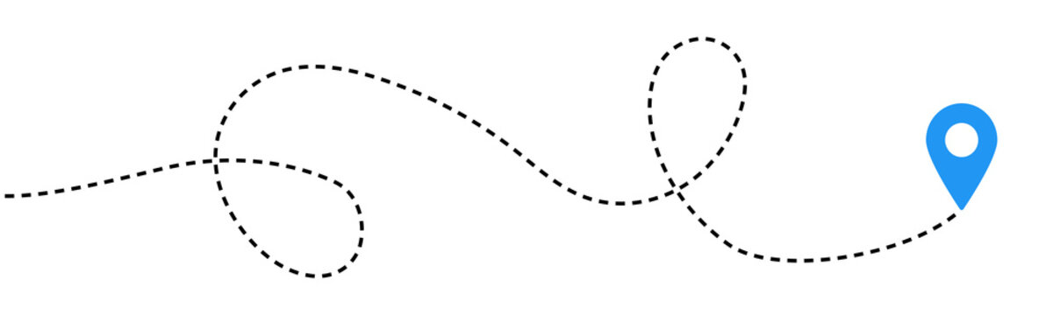
R v Hamilton, 2011 ONCA 399
“[T]he evidence given by the three employees of the carrier companies was not opinion evidence but factual evidence, which they were qualified to give because of their knowledge, observations and experience. Moreover, their evidence was reliable, probative and understandable. It was therefore properly admissible.”
“Importantly, none of the three cell phone witnesses was asked to give an opinion about the precise location of an appellant’s cell phone when a particular call was made or received. Evidence of that nature might well be opinion evidence and subject to the Mohan criteria … Testimony about the general rule [regarding cellphone towers] and its exceptions is not opinion evidence, and thus no voir dire was necessary. ”
Notes:
Court considered how other courts have characterized evidence about cellphone towers – specifically, the general rules about how they operate, and the exceptions to those rules (i.e., the closest tower will ping, except in certain conditions like where there is a water body present…)
Some courts had characterized it as opinion; others are factual evidence
ONCA characterized it as opinion evidence
The Crown’s witnesses are laying out a bunch of dots for the jury to connect here; they are providing specific circumstantial evidence about the location of the cellphone towers that were pinged, and background about how cellphone towers work, so that the jury can make the appropriate inferences and connect the dots
Notice that this abides by the division of labour between the witness and the jury

Slide 41
Specialized vs. Expert witnesses
“[T]he well-known decisions of the Ontario Court of Appeal in Hamilton, then Cyr, to which one can add the Ranger decision rendered a year prior. … stand for the proposition that specialized witnesses are limited to generalities, i.e., approximation, concerning geolocation. More specific, exact, or detailed geolocation requires expert evidence.”
(R. c. Mballa-Paulotte, 2024 QCCS 2840 at para. 594)

Slide 42
“[S]pecialized witnesses are limited to generalities, i.e., approximation, concerning geolocation. More specific, exact, or detailed geolocation requires expert evidence.”
(R. c. Mballa-Paulotte, 2024 QCCS 2840 at para. 594)
Fact or Opinion? | The deceased’s venous thrombosis precipitated by his cocaine use indicates a greater likelihood that the cocaine he ingested was adulterated with a vasodilating substance such as methamphetamine.

Slide 43
“[S]pecialized witnesses are limited to generalities, i.e., approximation, concerning geolocation. More specific, exact, or detailed geolocation requires expert evidence.”
(R. c. Mballa-Paulotte, 2024 QCCS 2840 at para. 594)
Fact or Opinion? | The deceased’s Venous thrombosis precipitated by his cocaine use indicates a greater likelihood that the cocaine he ingested was adulterated with a vasodilating substance such as methamphetamine.

Slide 44
Lira: “Won’t be drawing inferences”
R v Lira, 2021 ONSC 1766, aff’d 2023 ONCA 437
Officer Morden, Detective Constable, forensic analyst from Technological Crime Unit
Extracted Google Map images from accused’s cellphone
Conducted experiments to create comparator Google Map images

Slide 45
Lira: “Won’t be drawing inferences”
  Judge addressing Officer Morden:
  “I have ruled based on what [the Crown] has told me she anticipates is that you are going to tell me is purely factual evidence about what you did and what you observed, not opinion evidence. In other words, you won’t be drawing any inferences from what you did or observed …
  I understand that you did certain tests or what not, so I’ll be hearing about what you did and what you observed as a result and then we’ll go from there.”

Slide 46
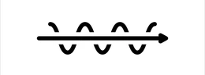
R v Hamilton, 2011 ONCA 399
“Even if evidence about the general rule [about cellphone towers] and its exceptions could at one time have been considered opinion evidence, it is now simply factual evidence … [The witnesses] were not proffering a novel scientific or behavioral theory that was open to debate. They were testifying about uncontroversial facts related to the operation of cell phone networks.”
“[T]he jury would have had no difficulty in understanding the cell phone location evidence, especially after it was summarized in a PowerPoint presentation. That presentation undoubtedly clarified the evidence and put to rest any possibility the jury might have been confused by it.”
Notes:
Addressing the fact that some courts had characterized it as opinion, the court said -

Slide 47
Durigon: “Ultimately incontrovertible”
“[W]here the evidence is not a novel social science or behavioural theory open to debate, but concerns facts related to the operation of technology, the evidence is properly regarded as simply factual technical information, ultimately incontrovertible, and not open to debate …
While the line may be difficult to draw in cases relating to human behaviour or novel science, and while there is an area of discretion in the court to determine whether the proposed evidence should only be admitted through an expert qualified to give an opinion, in cases such as this, involving knowledge of computers, the factual evidence should be admitted without requiring that the witness be qualified as an expert.”
(R. v. Durigon, 2017 ONSC 7075)

Slide 48
Durigon: “Ultimately incontrovertible”
  At issue was accuracy of dates recorded on computer hard drive: possible circumstantial evidence related to identity of person who accessed child pornography
  When asked about how access dates could have been updated, given that newer versions of Windows OS do not update access dates, Detective Constable Pinkerton (expert witness) revised his answer.
  Crown called Special Constable Bingham, digital forensic analyst; not proffered as an expert. He testified that newer versions of Windows OS do update access dates.
  Defence subsequently advised that it consulted two other persons with expertise on topic, received differing opinions; was considering whether to call further evidence.

Slide 49
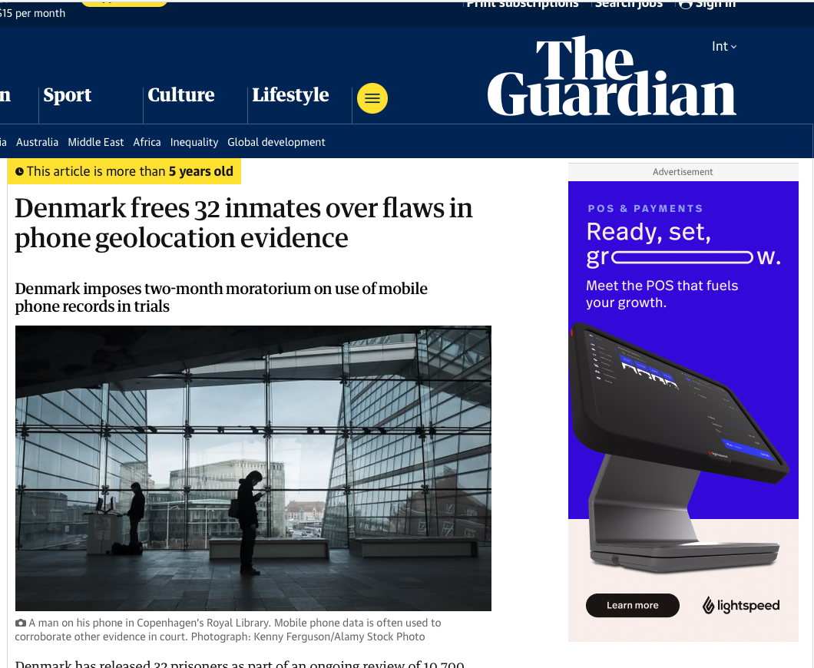
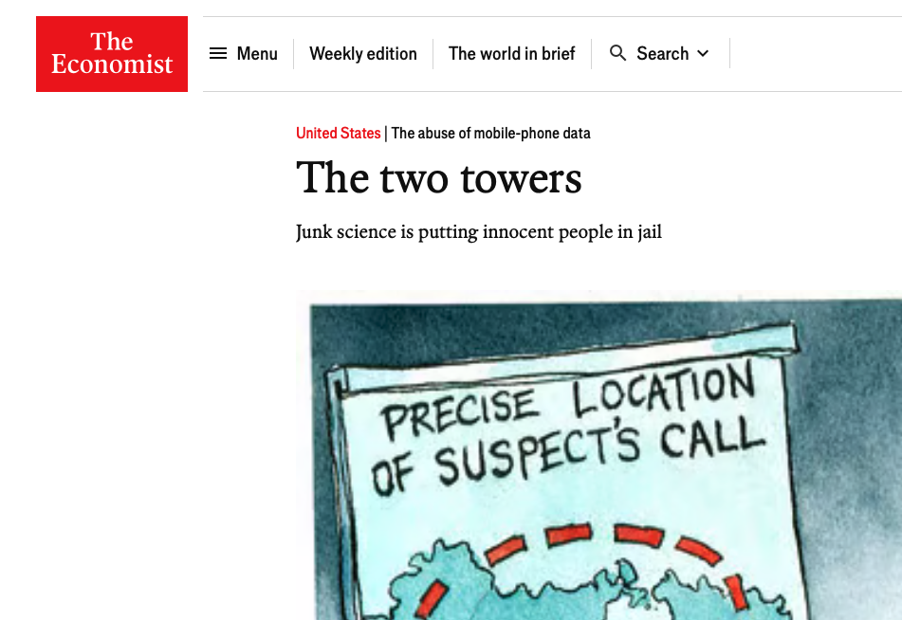

Slide 50
Hamilton: “The best reading”
“The concern for overuse of Mohan voir dires where technological evidence is offered is not just a question of efficiency. It is also a question of credibility. The repute of the administration of justice could not endure, in this modern age, courts that refuse to recognize and utilize technologies that are widespread and mundane. Risking exclusion by conducting Mohan voir dires, or setting up appeal opportunities by requiring them to be had is contrary to the public interest.”
(David M. Paciocco, “Proof and Progress: Coping with the Law of Evidence in a Technological Age” (2013) 11:2 Canadian Journal of Law and Technology 181, 187)

Slide 51
Hamilton: “The best reading”
“It is unlikely that the Court [in Hamilton] intended to reserve expert evidence scrutiny solely for cases where overt ‘opinions’ are offered, regardless of the special training it may take to make and offer relevant factual observations …
Established rules of expert evidence apply to all evidence that requires special education or training that goes beyond the ken of ordinary persons, with more intense application in the case of ‘novel scientific or behavioural theory.’”
(Ibid at 187-88)

Slide 52
Hamilton: “The best reading”
“It is best to read Hamilton as holding that a full-bore Mohan voir dire may not be required where the evidence in question is:
  [1] familiar to courts …
  [2] presented as circumstantial evidence rather than as direct opinion on an issue to be decided, and …
  [3] based on uncontroversial principles that can be easily understood.”
(Ibid at 187-88)

Slide 53
[1] Familiar to courts
[2] Presented as circumstantial evidence rather than as direct opinion on an issue to be decided | Witness states facts, judge/jury draws inferences
[3] Based on uncontroversial principles that can be easily understood

Slide 54
[1] Familiar to courts | Necessity? Reliability?
[2] Presented as circumstantial evidence rather than as direct opinion on an issue to be decided | Witness states facts, judge/jury draws inferences
[3] Based on uncontroversial principles that can be easily understood | Necessity? Reliability?

Slide 55
Summary of key observations…
The fact/opinion distinction has limited significance in the lay context
  Misclassification carries limited practical implications; issue rarely arises
The fact/opinion distinction is very important in the expert context
  Misclassification carries high risk to truth-seeking process:
    Expert opinion => meaningful risk of unreliability, high scrutiny for reliability
    Expert fact => meaningful risk of unreliability, limited scrutiny for reliability
The expert opinion admissibility test has become increasingly focused on reliability
  Growing misalignment with the rationale for presumptively excluding

Slide 56
Two key problems…
Growing misalignment with the rationale for presumptively excluding expert opinion evidence, admitting it under exception. Could be fixed by:
    Adjusting admissibility test to decrease focus on reliability, to focus on role of witness
    Rethinking rationale for presumptively excluding expert opinion, to focus on reliability
Specialized/expert fact => risk of unreliability, limited scrutiny for reliability.
    Would be exacerbated by adjusting test to decrease focus on reliability
    Would be reduced by rethinking rationale for presumptively excluding expert opinion, to focus on reliability – and by applying that same presumption of inadmissibility to expert factual evidence

Slide 57
 | LAY EVIDENCE | EXPERT EVIDENCE
FACTUAL (OBSERVATIONAL) EVIDENCE | LAY FACTUAL EVIDENCE Presumptively admissible | EXPERT EVIDENCE Presumptively inadmissible Apply expert opinion evidence rule (White Burgess; Mohan Factors)
OPINION EVIDENCE | LAY OPINION EVIDENCE Presumptively inadmissible; Apply lay opinion evidence rule (Graat)

Slide 58
conclusion (and further challenges)
CONCLUSION:
  The fact/opinion distinction should NOT be treated as primary
  We should focus, first and foremost, on lay/expert distinction
  All expert/specialized evidence should be treated as presumptively inadmissible
CHALLENGES:
  Expert status can increase cost, delay
  Expert status can increase perceived reliability
  Proposed shift would raise the stakes for the tricky lay/expert distinction
    A (partial) response: better to locate taxonomical disputes within a sensible, purposive framework
    A (possible) response: could scrutiny of specific expert evidence be calibrated to reflect its risk?

Slide 59
Thank you!
ppaciocco@osgoode.yorku.ca

